Slide 1
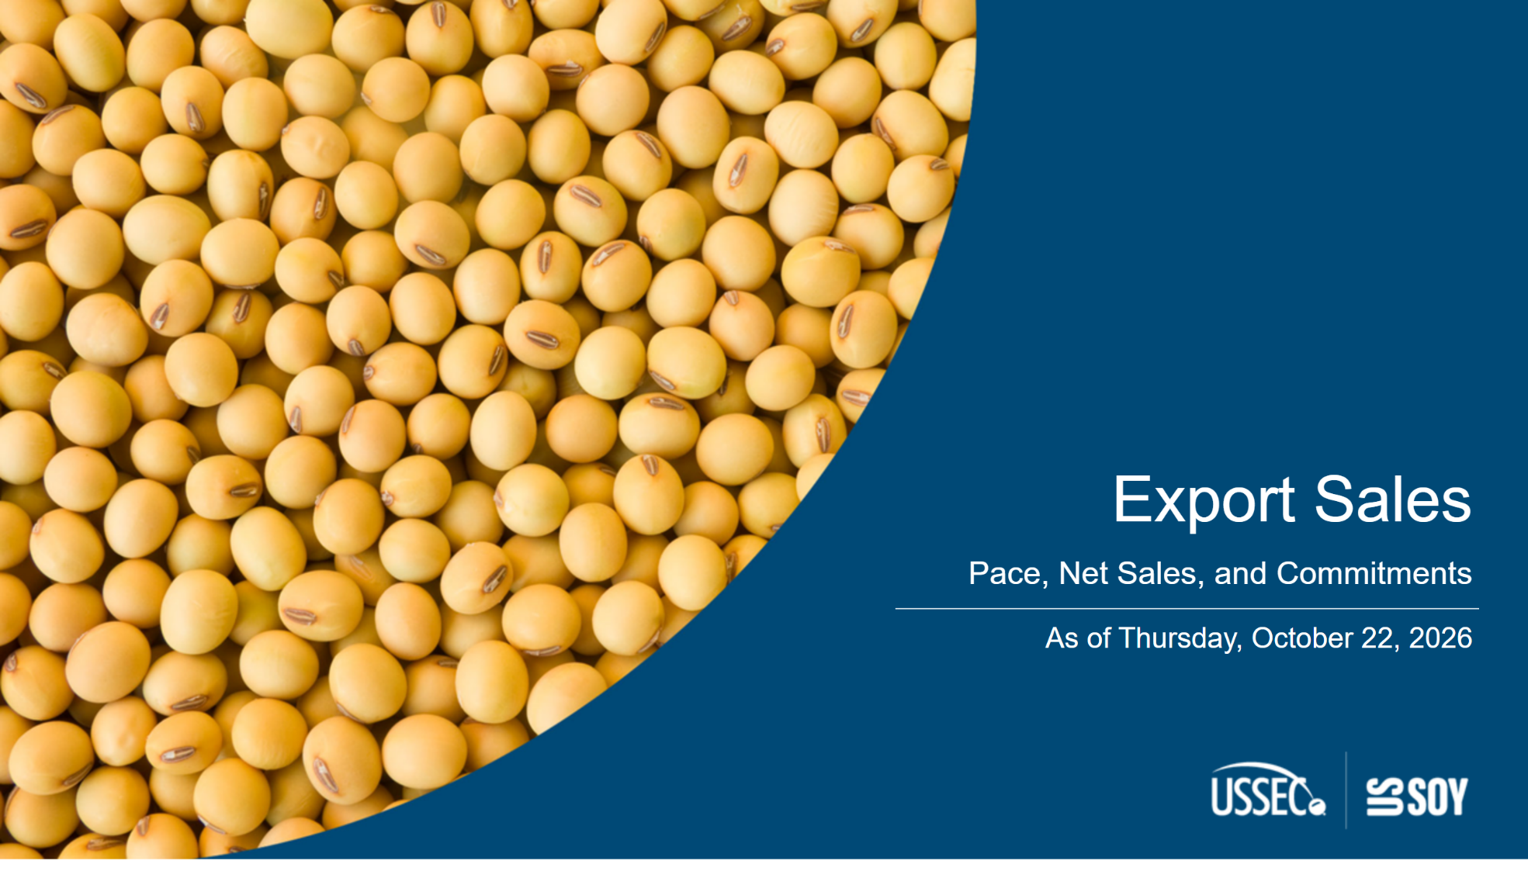
ExportSalesCover
Notes:
textbox
No alt text provided
textbox
No alt text provided
shape
No alt text provided

Slide 2
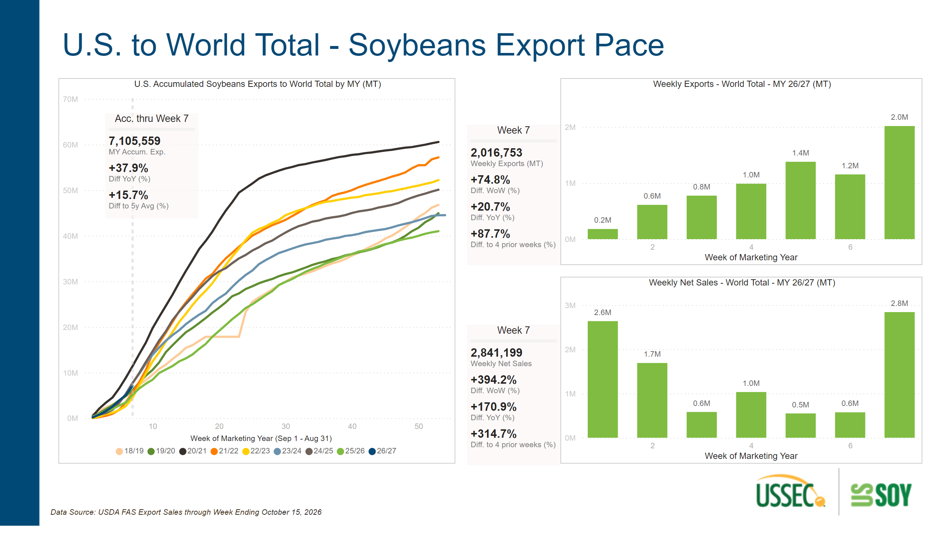
Export Pace - SB - World
Notes:
textbox
No alt text provided
Weekly Exports - World Total - MY 26/27 (MT)
No alt text provided
U.S. Accumulated Soybeans Exports to World Total by MY (MT)
No alt text provided
Acc. thru Week 7
No alt text provided
Week 7
No alt text provided
Weekly Net Sales - World Total - MY 26/27 (MT)
No alt text provided
textbox
No alt text provided
Week 7
No alt text provided
textbox
No alt text provided

Slide 3
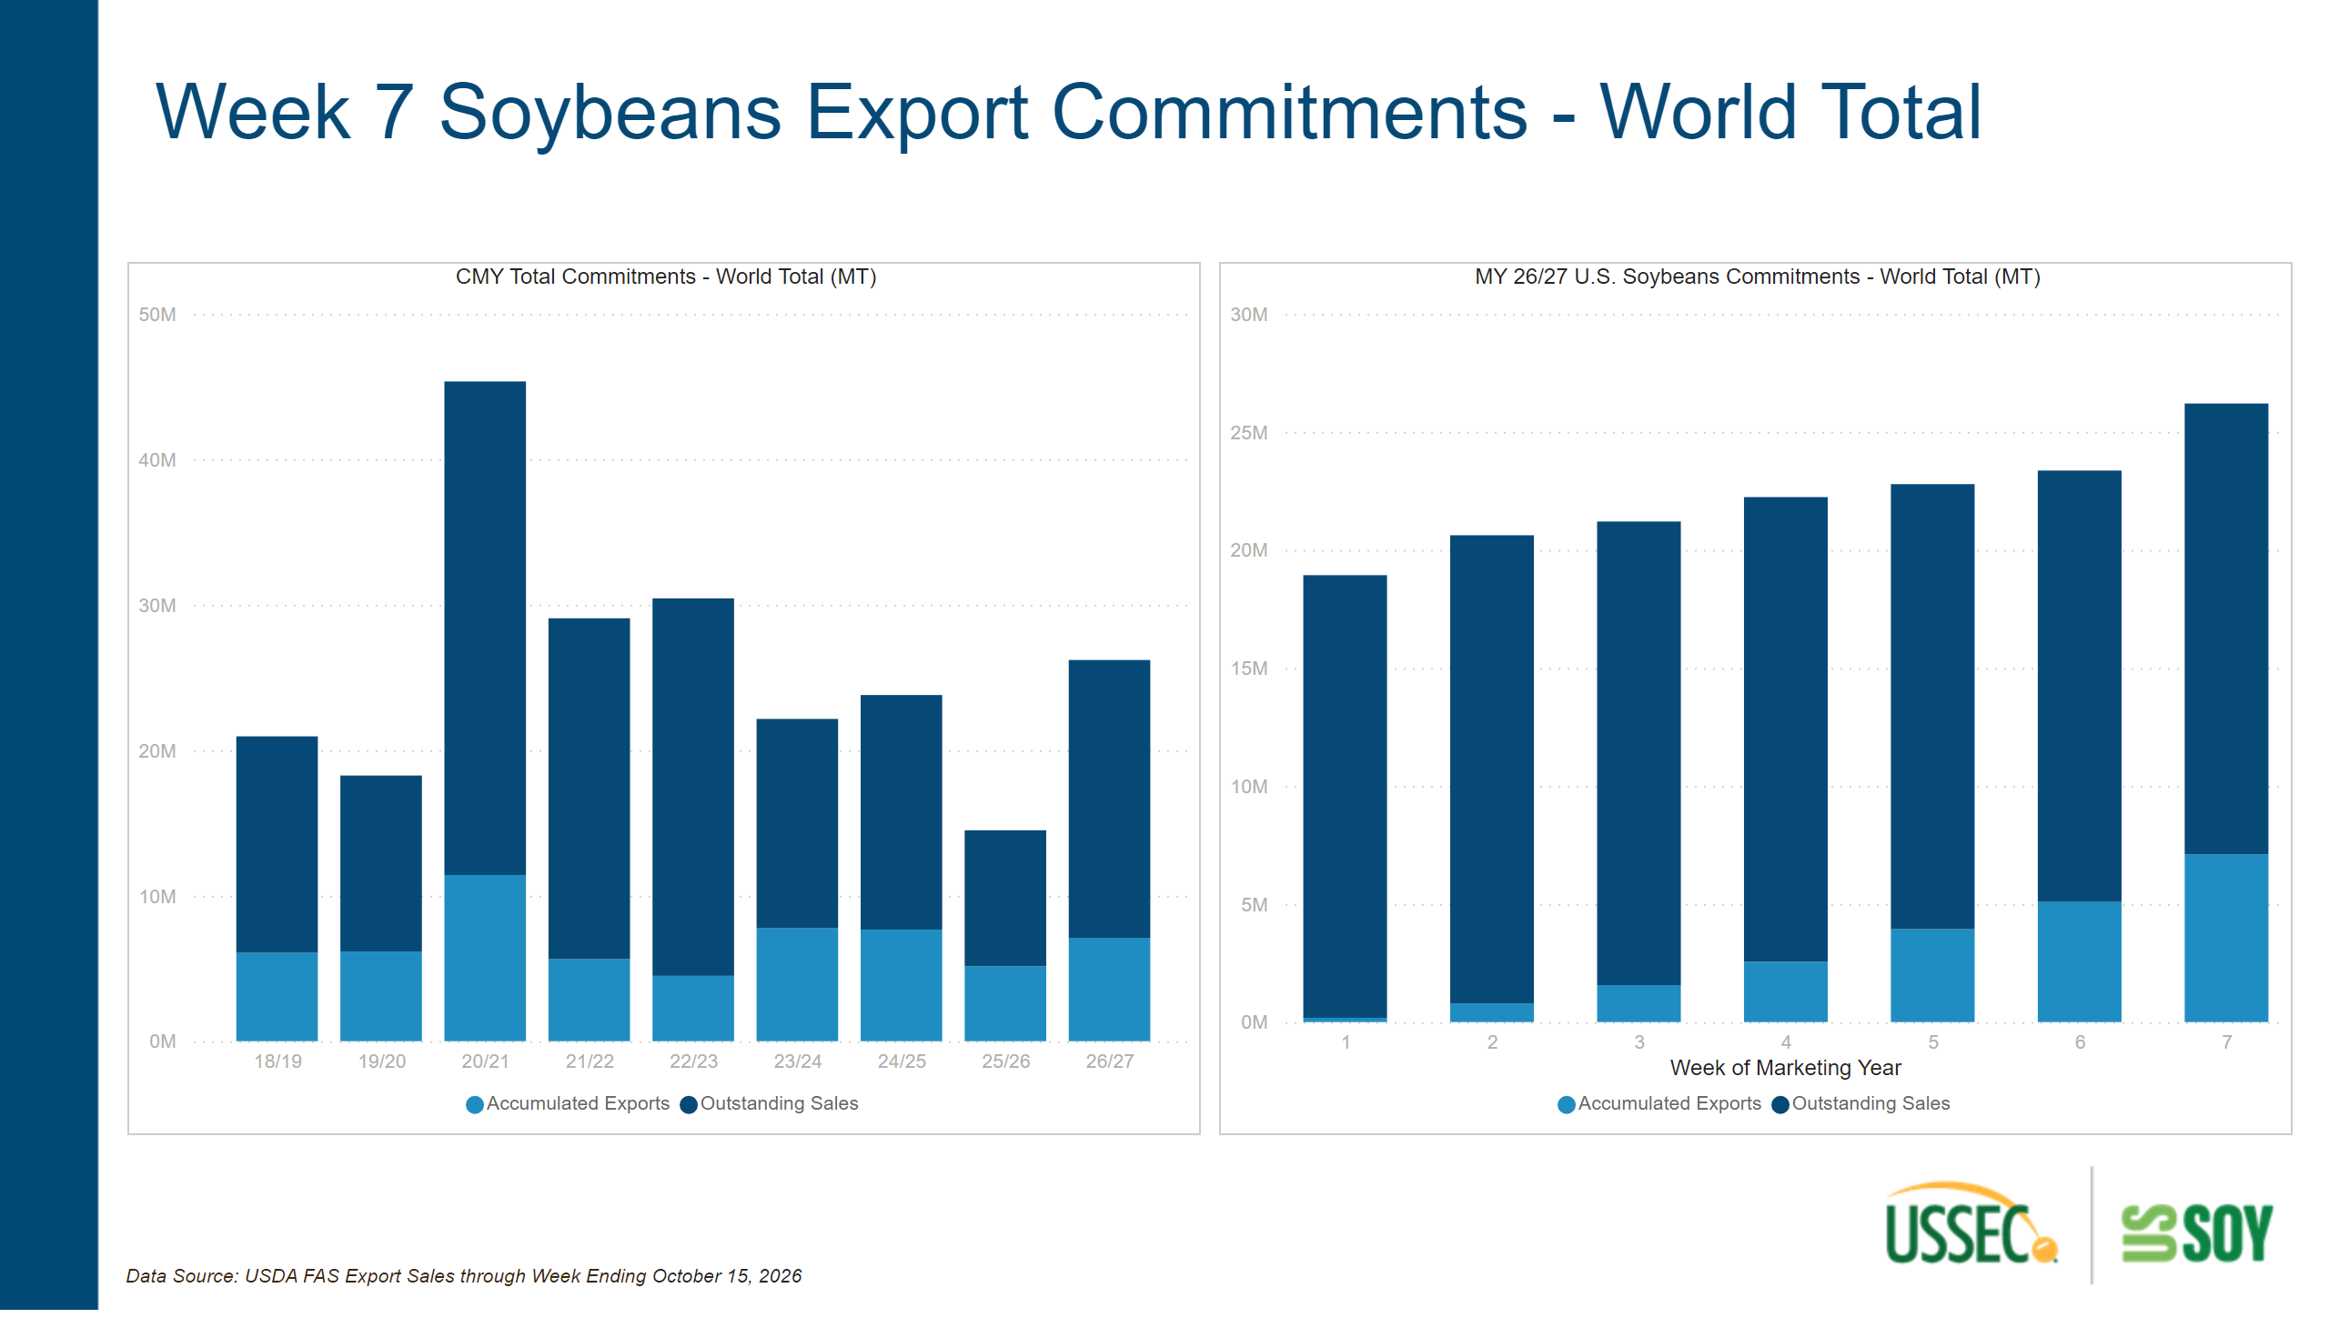
Export Commitments - SB - World
Notes:
textbox
No alt text provided
textbox
No alt text provided
CMY Total Commitments - World Total (MT)
No alt text provided
MY 26/27 U.S. Soybeans Commitments - World Total (MT)
No alt text provided

Slide 4
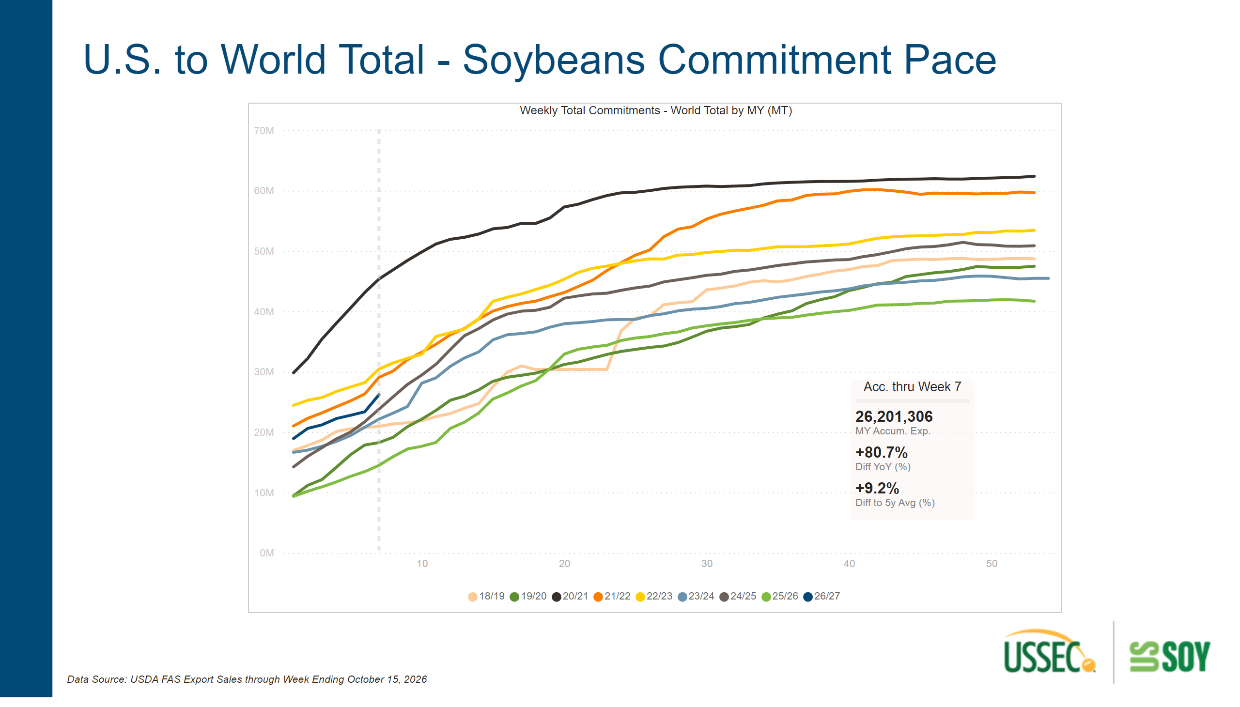
Duplicate of Export Pace - SB - World
Notes:
textbox
No alt text provided
Acc. thru Week 7
No alt text provided
textbox
No alt text provided
Weekly Total Commitments - World Total by MY (MT)
No alt text provided

Slide 5
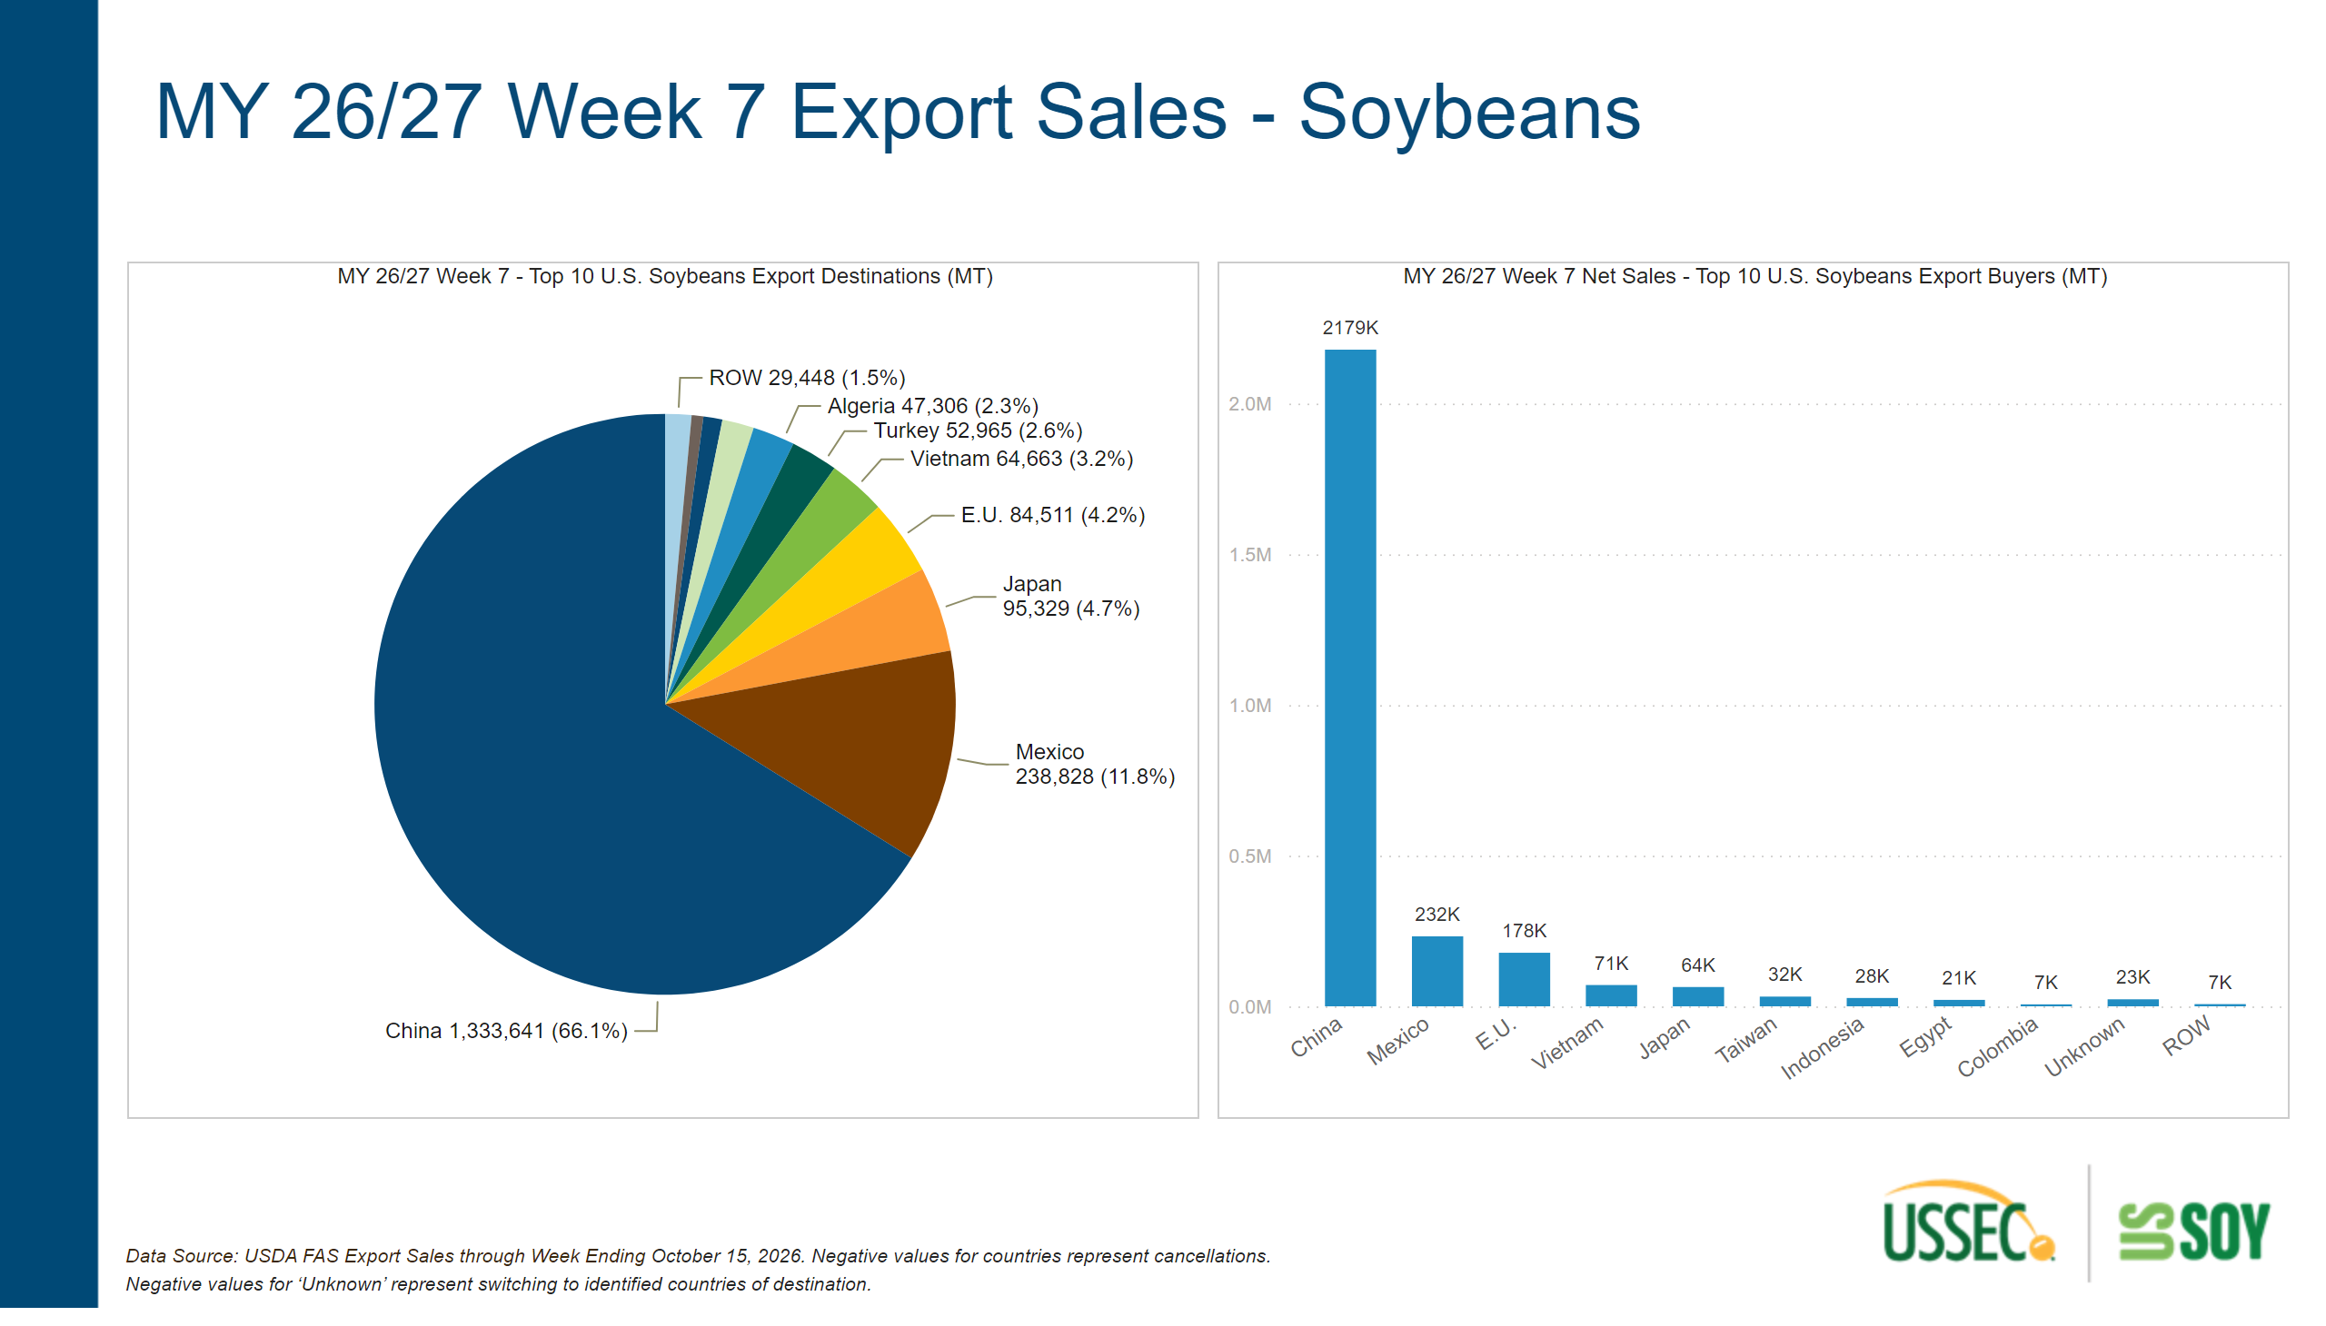
Weekly Sales - SB - World
Notes:
MY 26/27 Week 7 - Top 10 U.S. Soybeans Export Destinations (MT)
No alt text provided
textbox
No alt text provided
textbox
No alt text provided
MY 26/27 Week 7 Net Sales - Top 10 U.S. Soybeans Export Buyers (MT)
No alt text provided

Slide 6
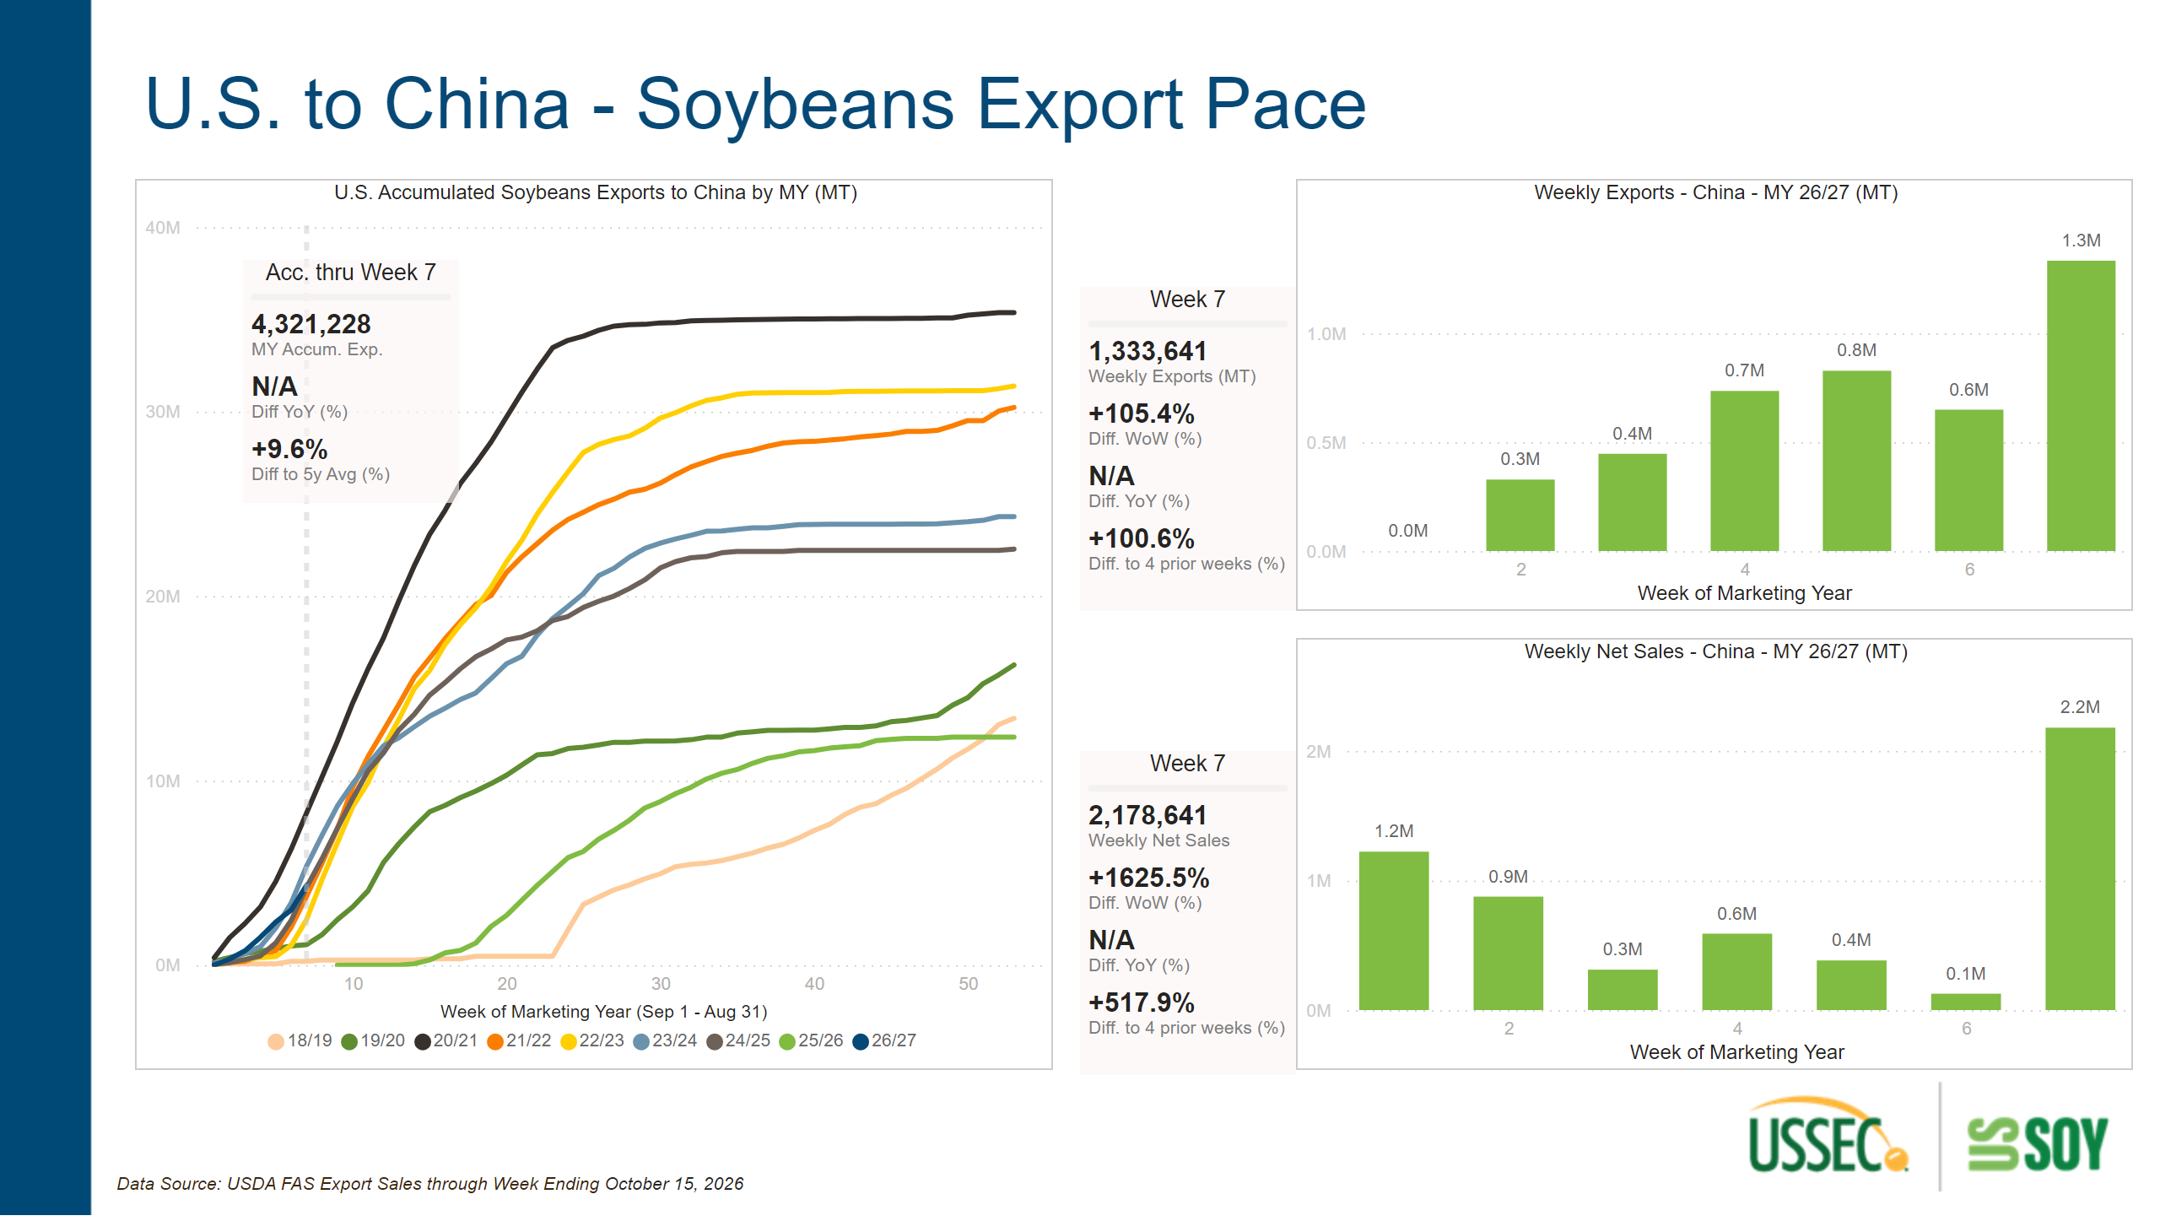
Export Pace - SB - China
Notes:
Weekly Net Sales - China - MY 26/27 (MT)
No alt text provided
Acc. thru Week 7
No alt text provided
Week 7
No alt text provided
U.S. Accumulated Soybeans Exports to China by MY (MT)
No alt text provided
textbox
No alt text provided
textbox
No alt text provided
textbox
No alt text provided
Week 7
No alt text provided
Weekly Exports - China - MY 26/27 (MT)
No alt text provided

Slide 7
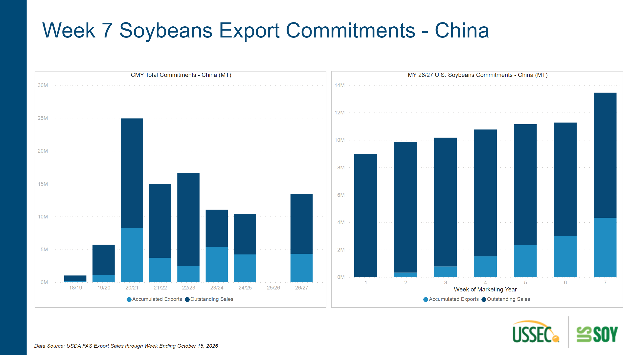
Export Commitments - SB - China
Notes:
CMY Total Commitments - China (MT)
No alt text provided
textbox
No alt text provided
MY 26/27 U.S. Soybeans Commitments - China (MT)
No alt text provided
textbox
No alt text provided

Slide 8
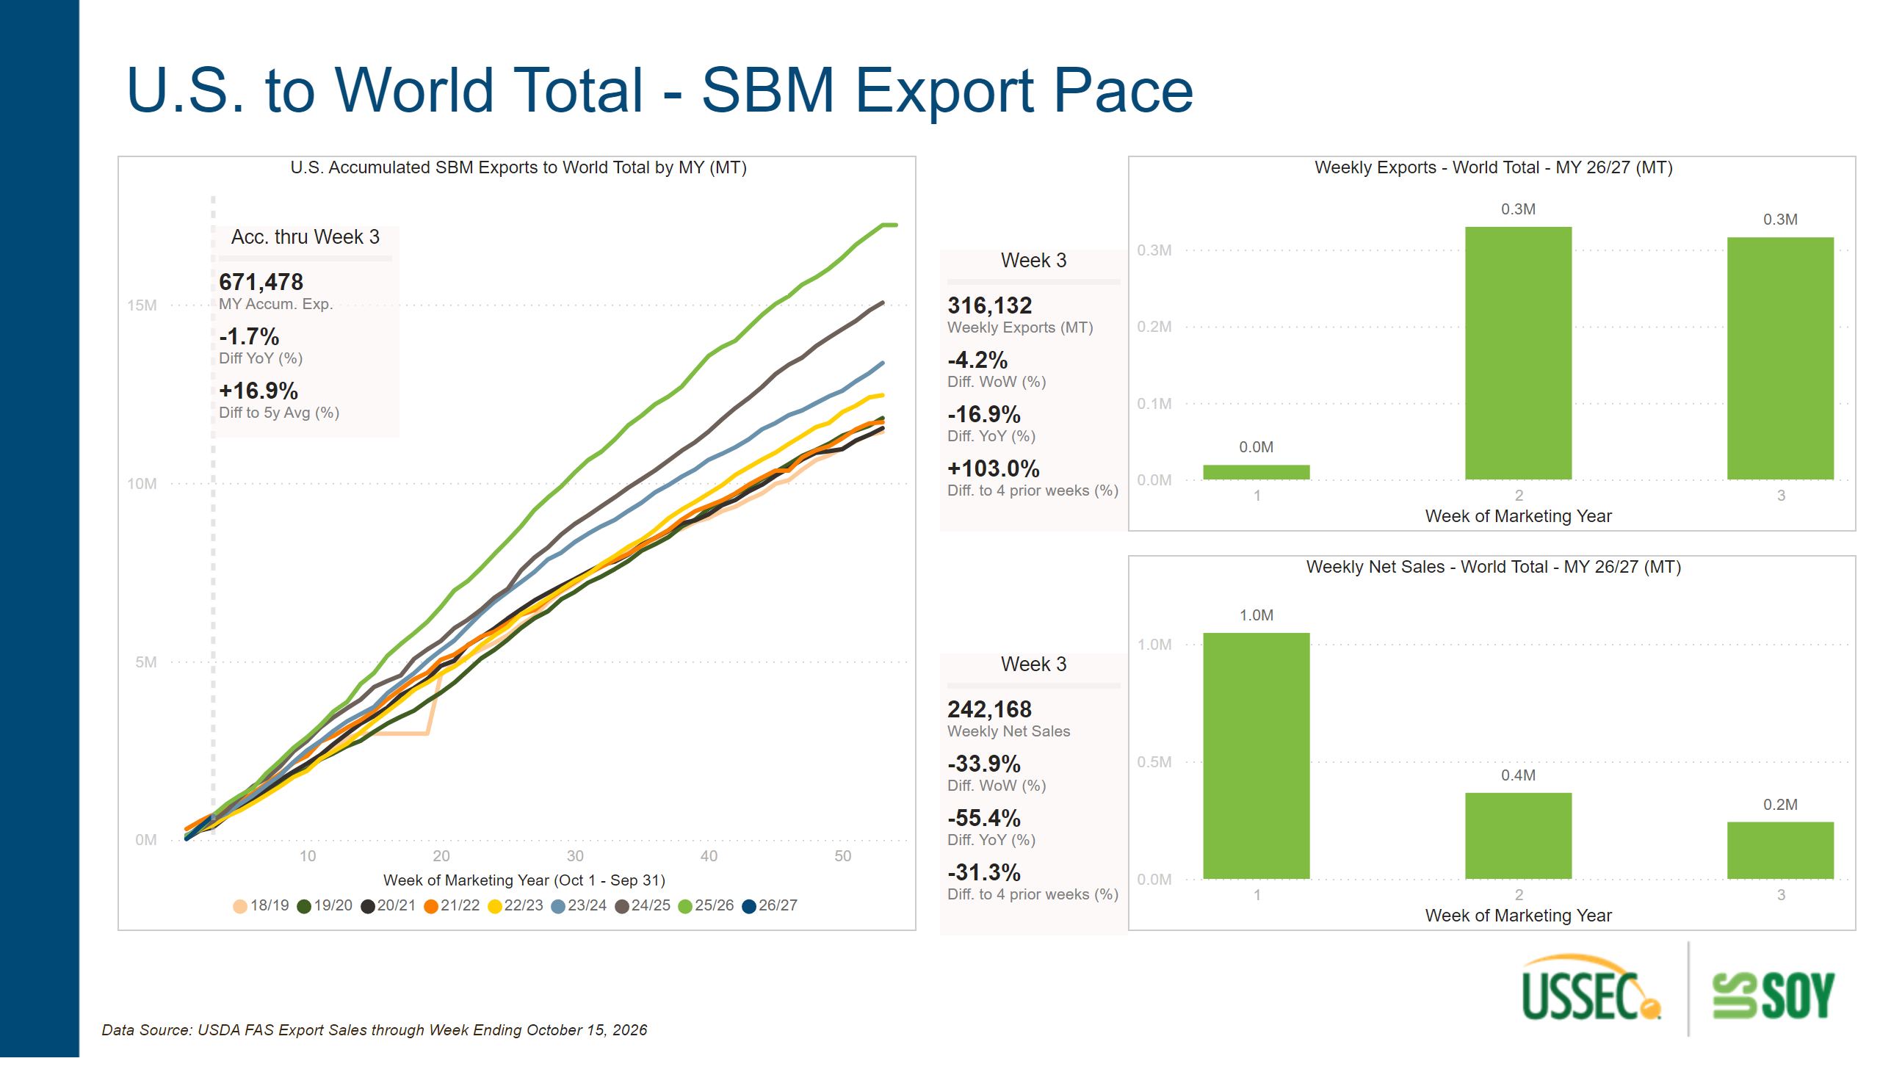
Export Pace - SBM - World
Notes:
textbox
No alt text provided
Week 3
No alt text provided
U.S. Accumulated SBM Exports to World Total by MY (MT)
No alt text provided
textbox
No alt text provided
Weekly Exports - World Total - MY 26/27 (MT)
No alt text provided
Acc. thru Week 3
No alt text provided
textbox
No alt text provided
Weekly Net Sales - World Total - MY 26/27 (MT)
No alt text provided
Week 3
No alt text provided

Slide 9
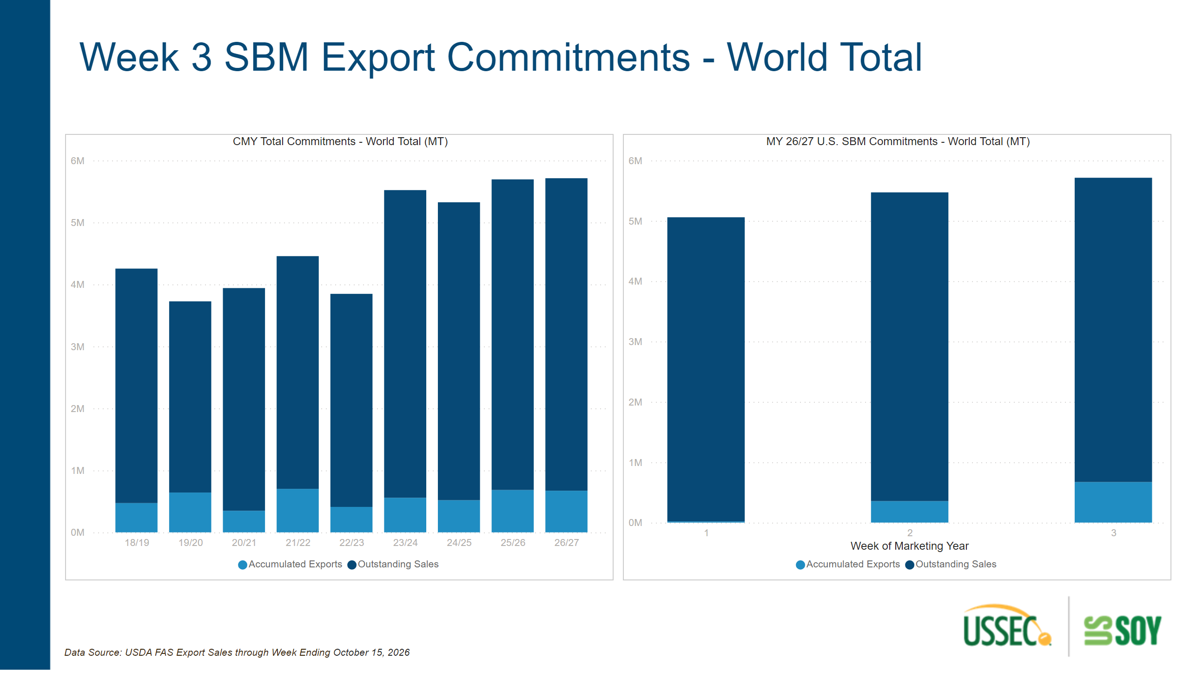
Export Commitments - SBM - World
Notes:
textbox
No alt text provided
MY 26/27 U.S. SBM Commitments - World Total (MT)
No alt text provided
CMY Total Commitments - World Total (MT)
No alt text provided
textbox
No alt text provided

Slide 10
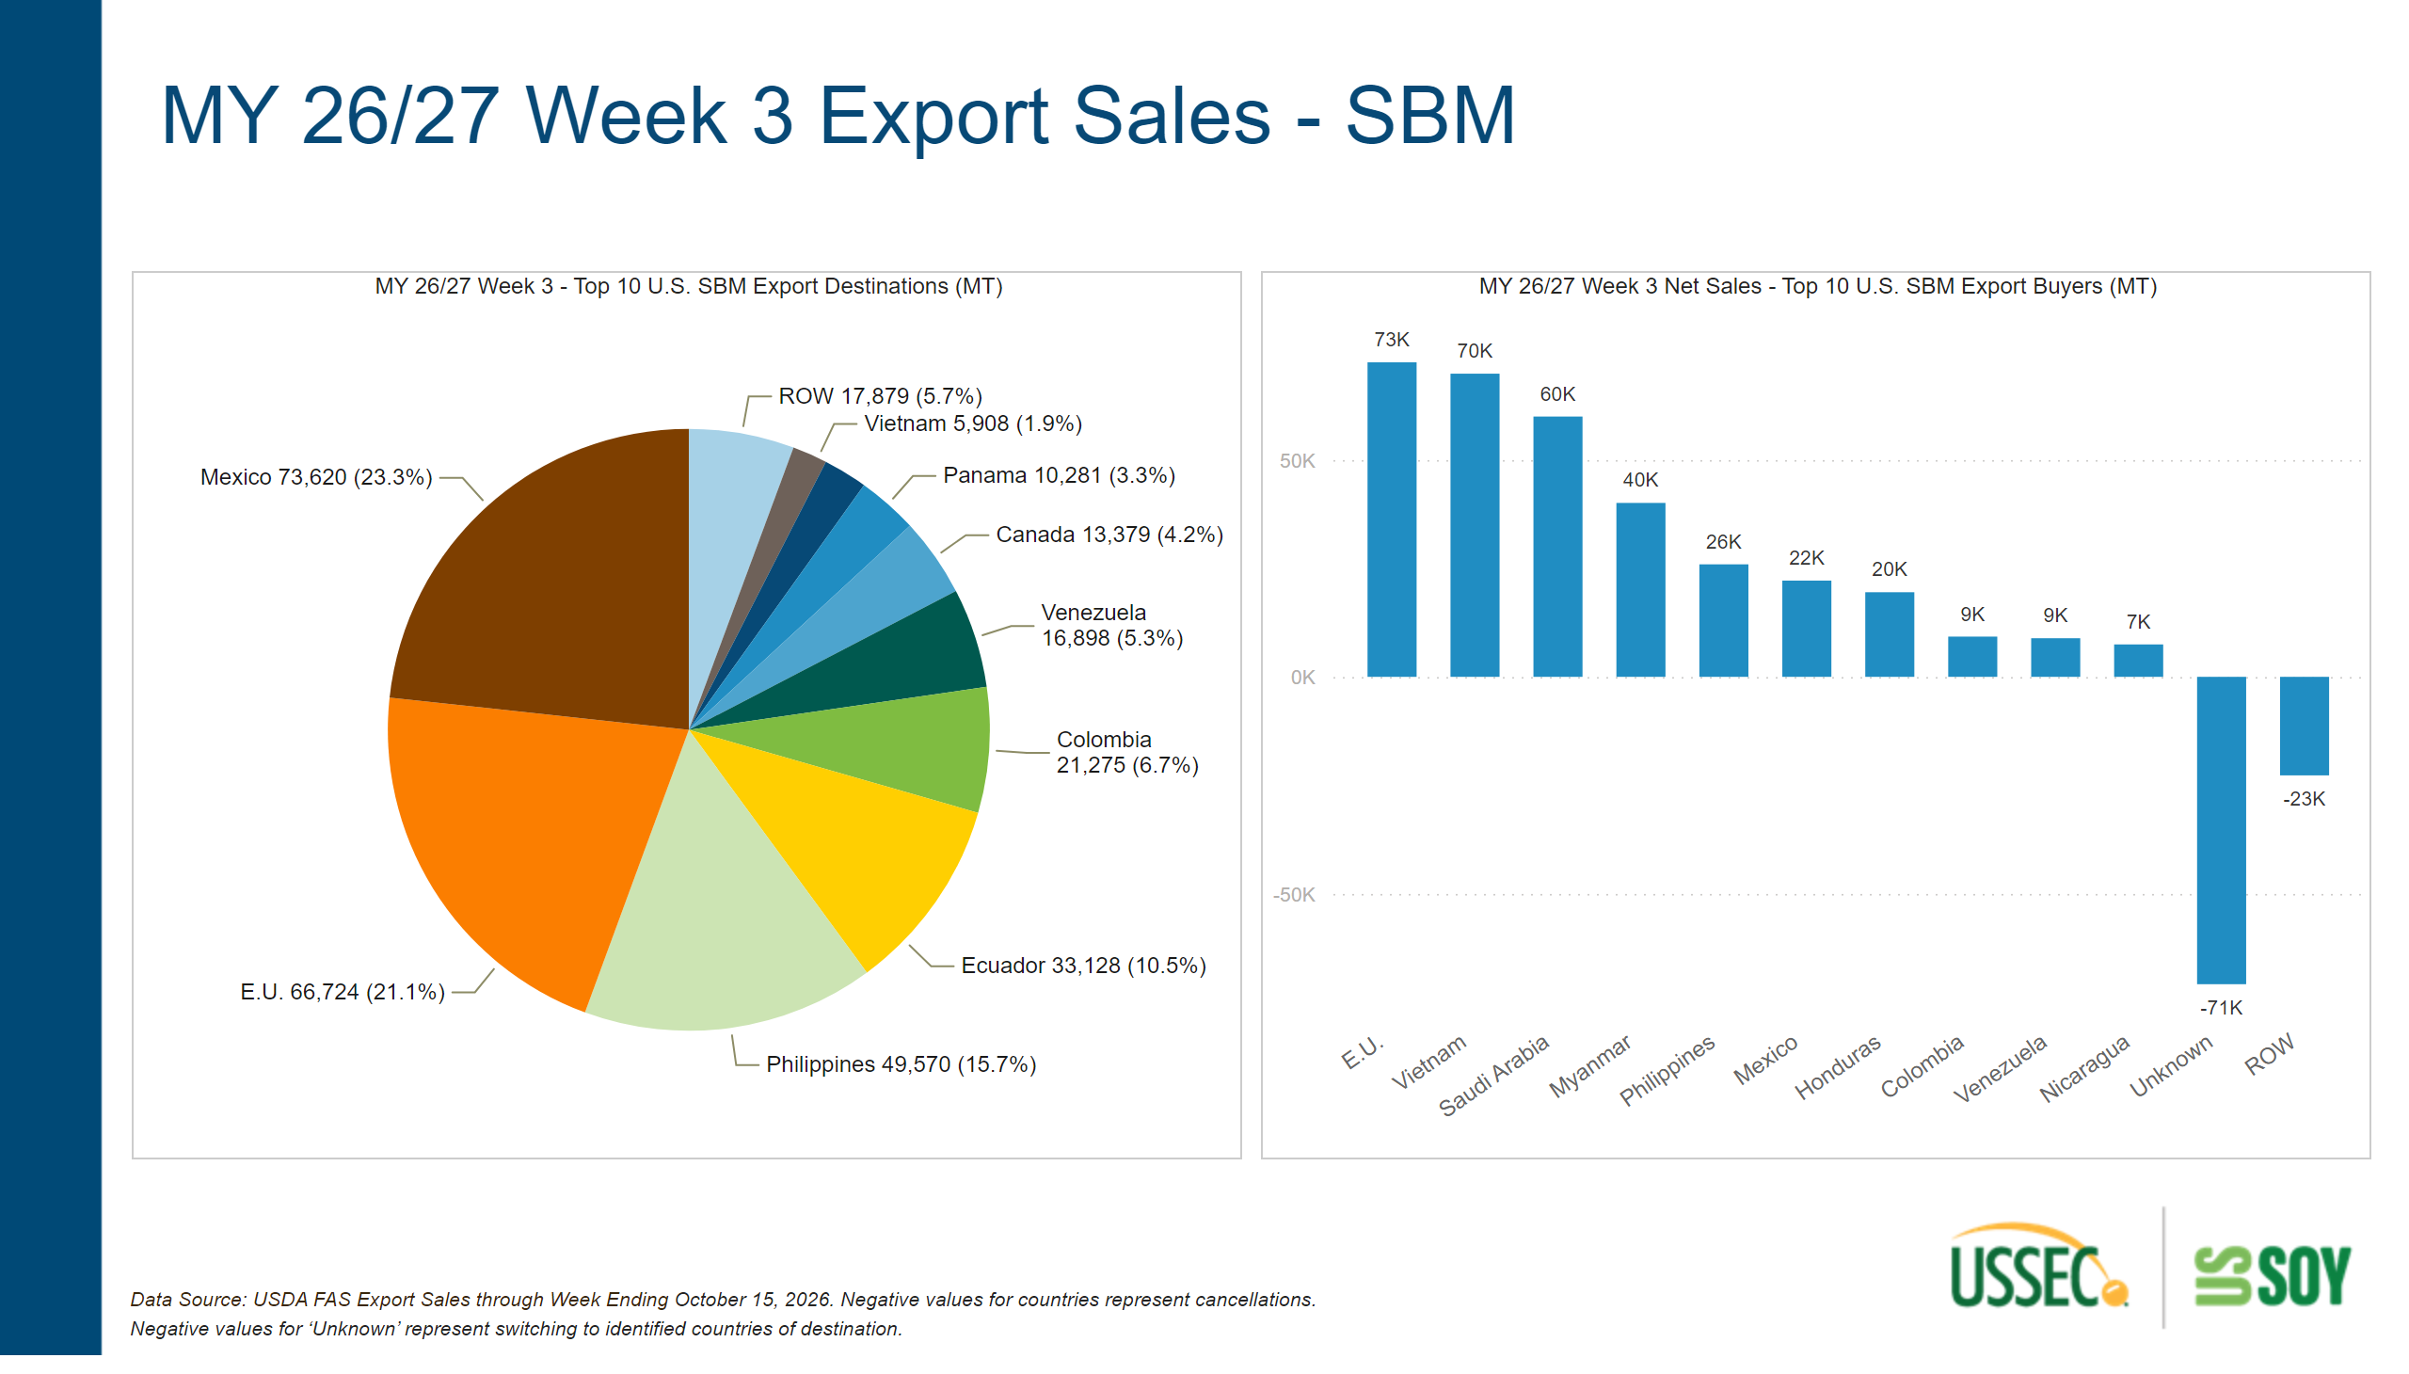
Weekly Sales - SBM - World
Notes:
textbox
No alt text provided
MY 26/27 Week 3 Net Sales - Top 10 U.S. SBM Export Buyers (MT)
No alt text provided
textbox
No alt text provided
MY 26/27 Week 3 - Top 10 U.S. SBM Export Destinations (MT)
No alt text provided

Slide 11
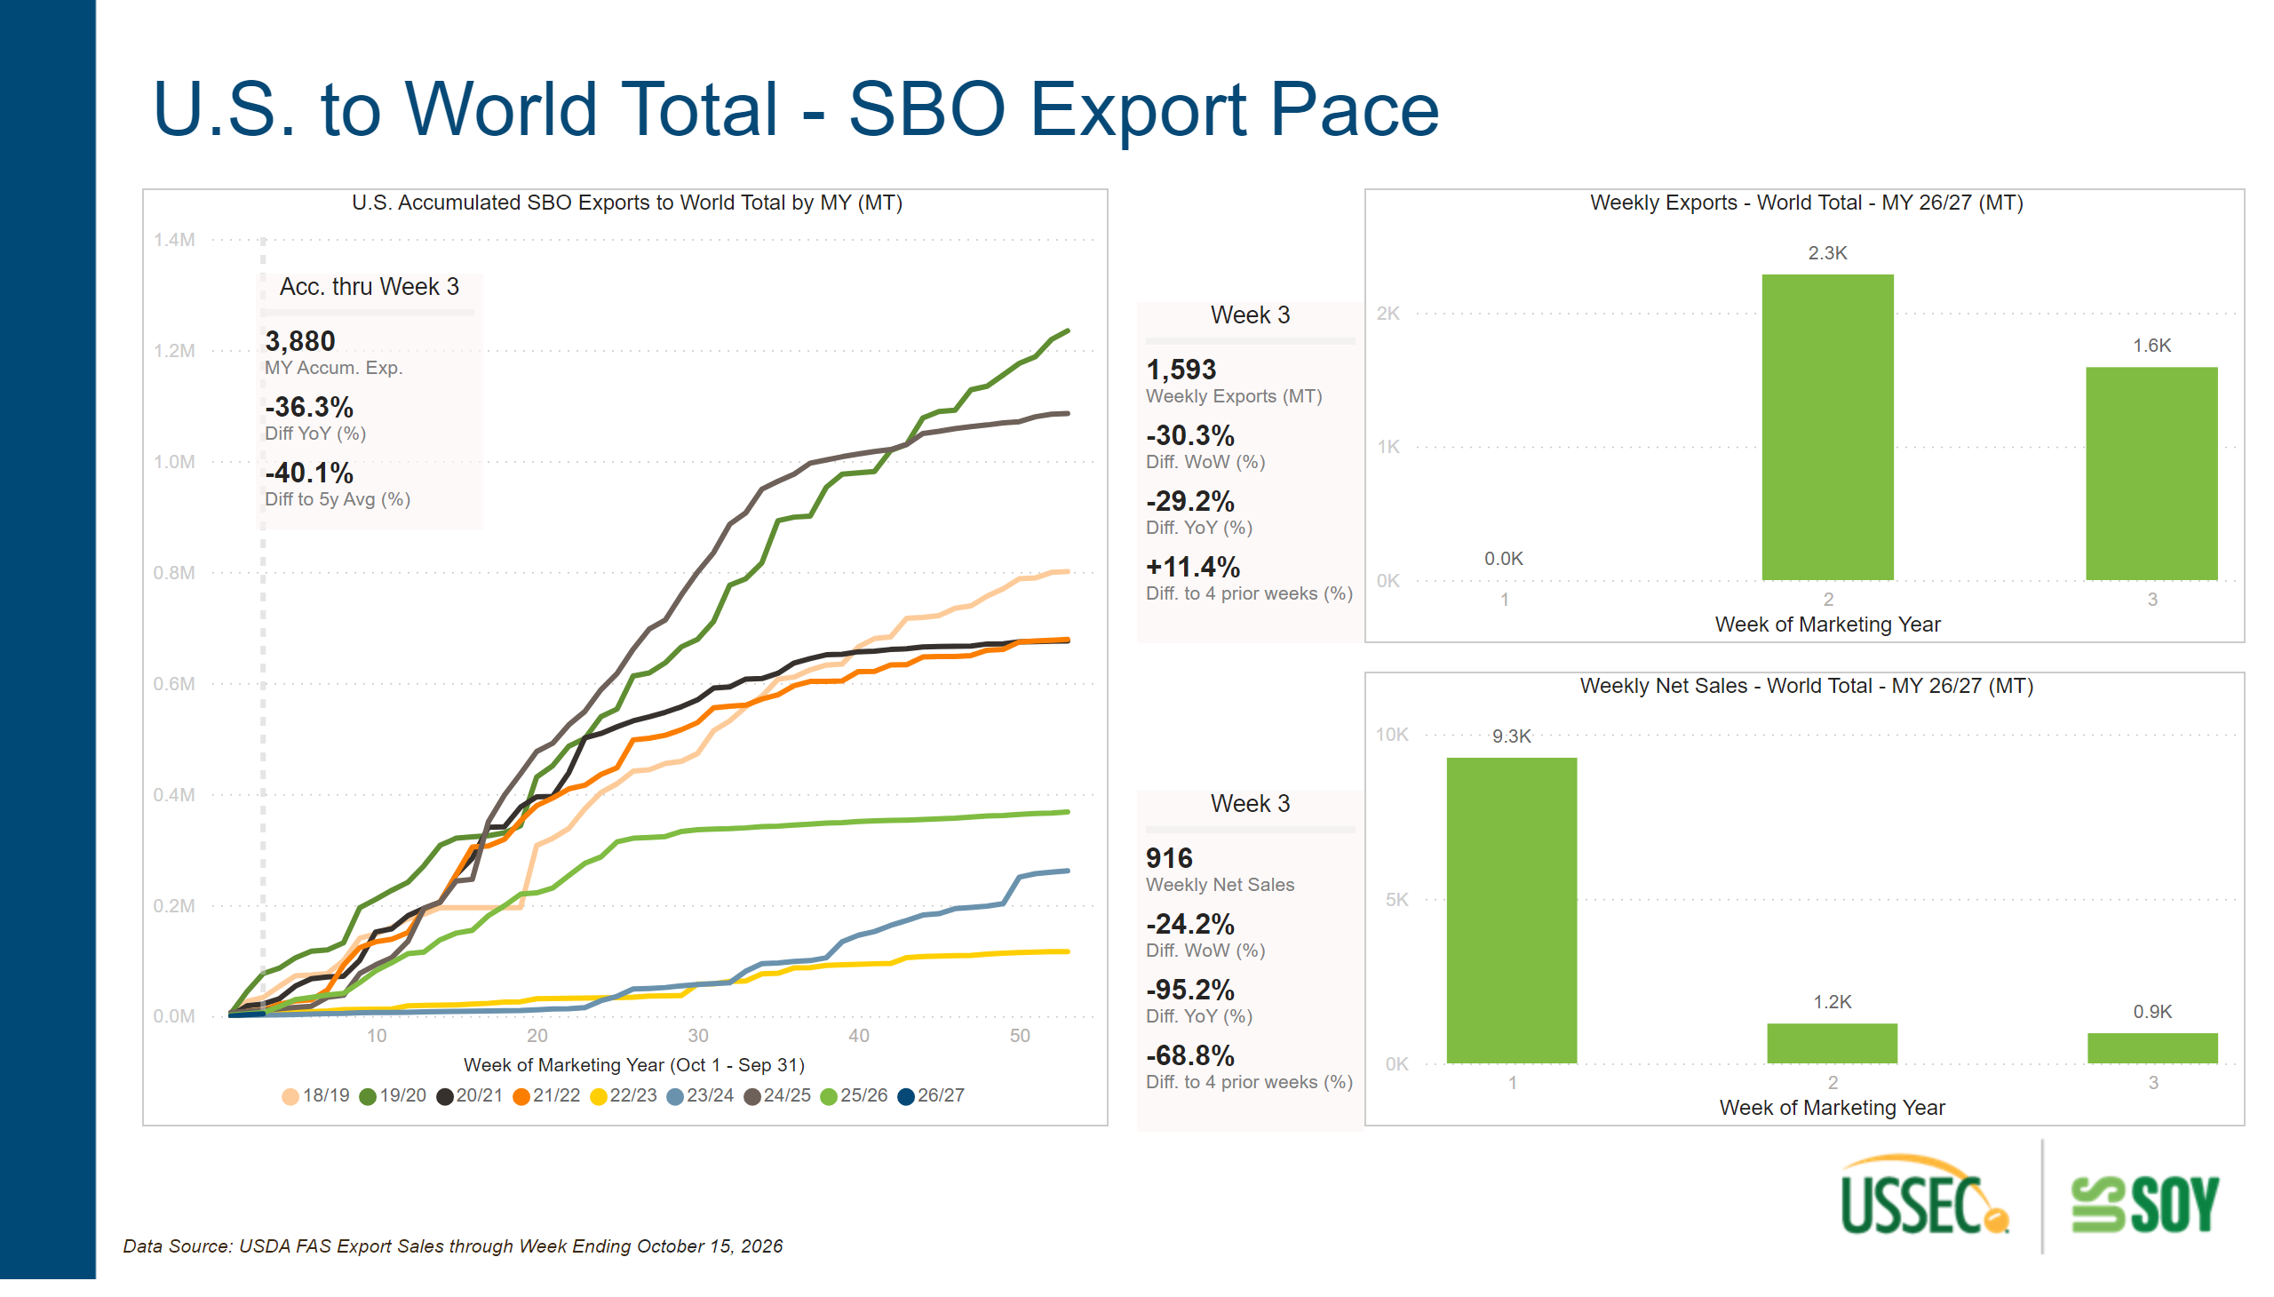
Export Pace - SBO - World
Notes:
Weekly Net Sales - World Total - MY 26/27 (MT)
No alt text provided
textbox
No alt text provided
Week 3
No alt text provided
Weekly Exports - World Total - MY 26/27 (MT)
No alt text provided
Acc. thru Week 3
No alt text provided
textbox
No alt text provided
textbox
No alt text provided
Week 3
No alt text provided
U.S. Accumulated SBO Exports to World Total by MY (MT)
No alt text provided

Slide 12
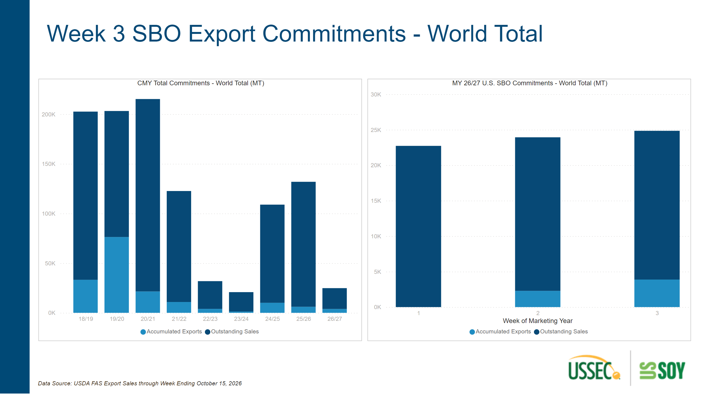
Export Commitments - SBO - World
Notes:
textbox
No alt text provided
textbox
No alt text provided
MY 26/27 U.S. SBO Commitments - World Total (MT)
No alt text provided
CMY Total Commitments - World Total (MT)
No alt text provided

Slide 13
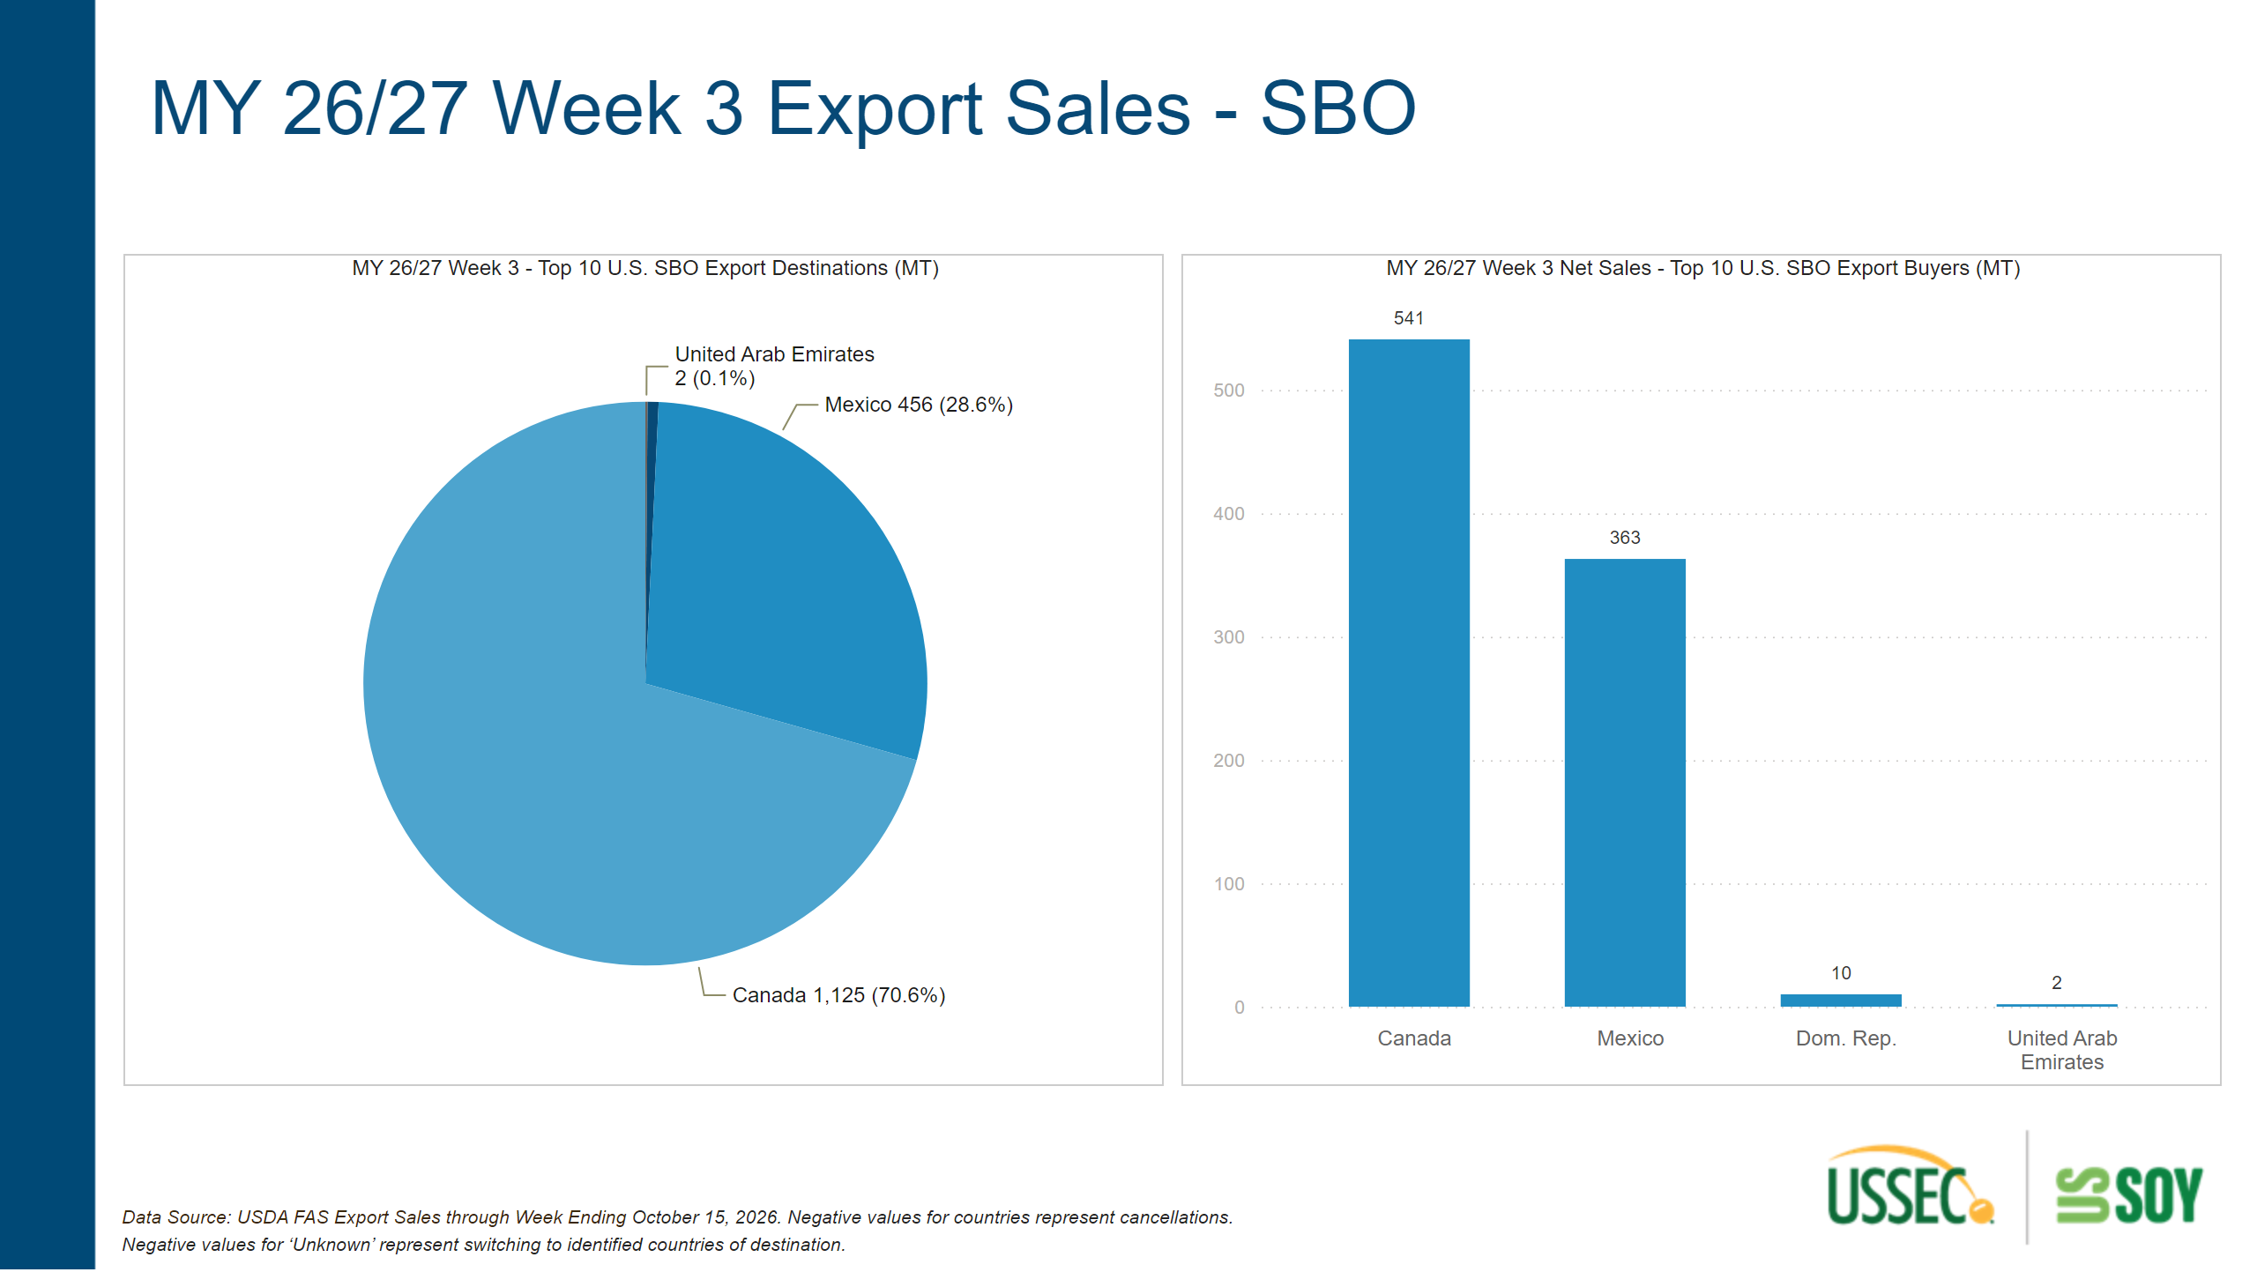
Weekly Sales - SBO - World
Notes:
MY 26/27 Week 3 Net Sales - Top 10 U.S. SBO Export Buyers (MT)
No alt text provided
textbox
No alt text provided
MY 26/27 Week 3 - Top 10 U.S. SBO Export Destinations (MT)
No alt text provided
textbox
No alt text provided

Slide 14
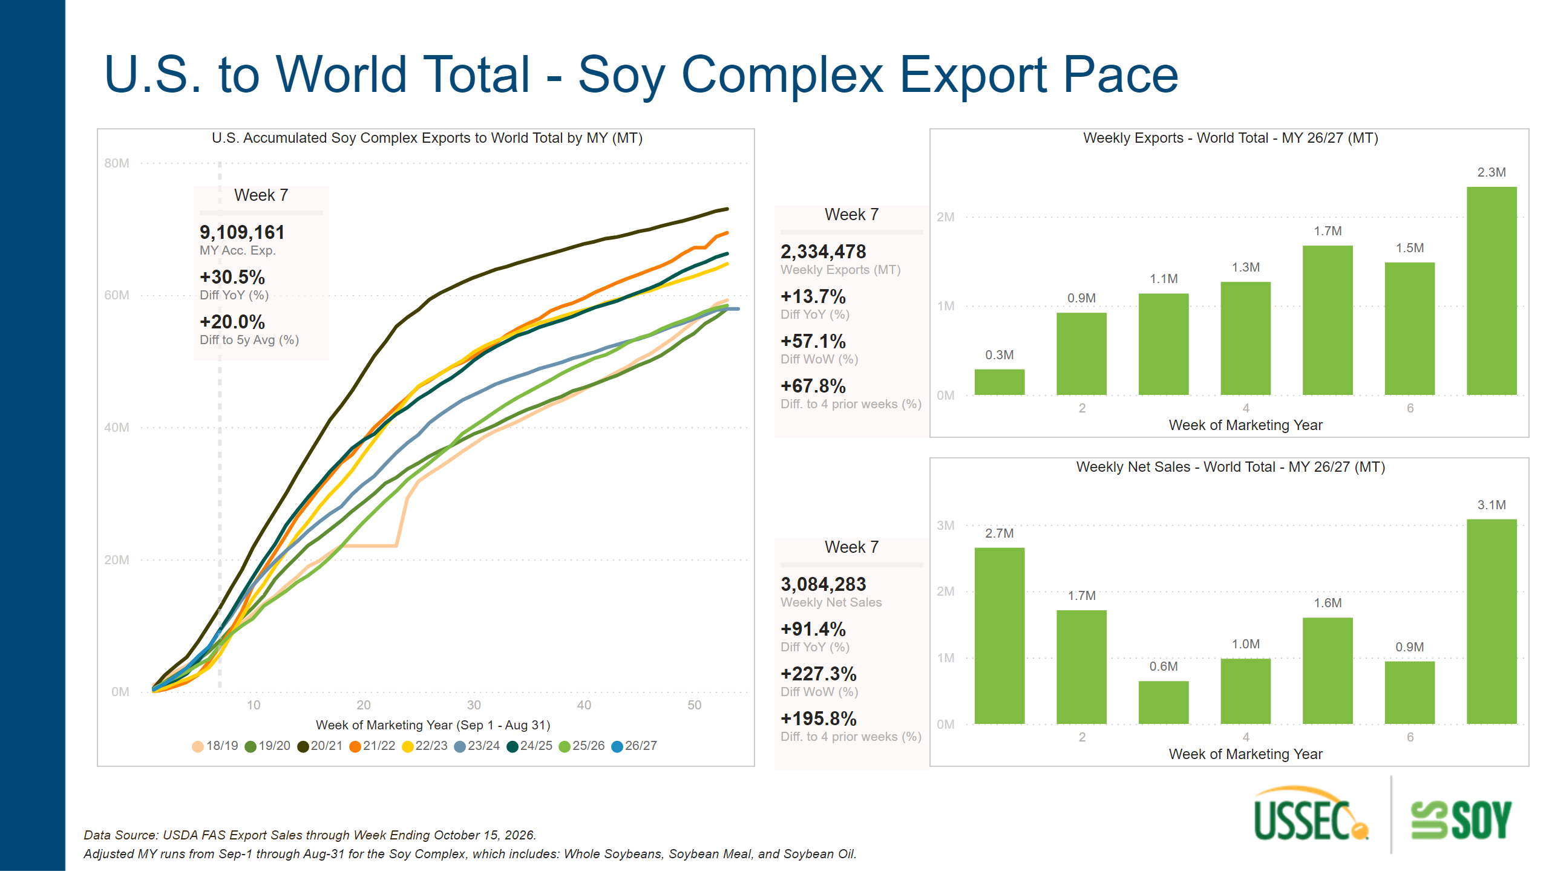
Export Pace - All Commodities - World
Notes:
textbox
No alt text provided
Weekly Net Sales - World Total - MY 26/27 (MT)
No alt text provided
Week 7
No alt text provided
textbox
No alt text provided
Week 7
No alt text provided
textbox
No alt text provided
Week 7
No alt text provided
Weekly Exports - World Total - MY 26/27 (MT)
No alt text provided
U.S. Accumulated Soy Complex Exports to World Total by MY (MT)
No alt text provided

Slide 15
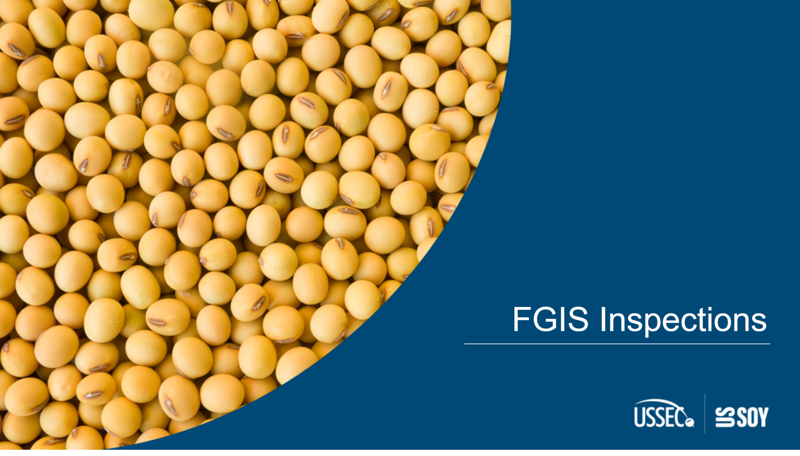
FGISCover
Notes:
textbox
No alt text provided
shape
No alt text provided

Slide 16
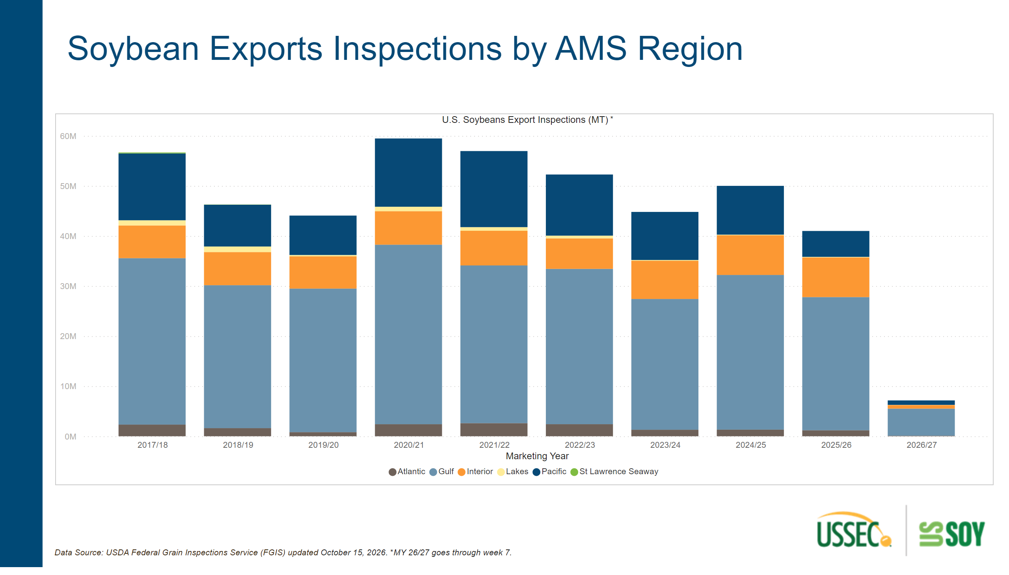
Inspections by Region
Notes:
textbox
No alt text provided
textbox
No alt text provided
U.S. Soybeans Export Inspections (MT)
No alt text provided
textbox
No alt text provided

Slide 17
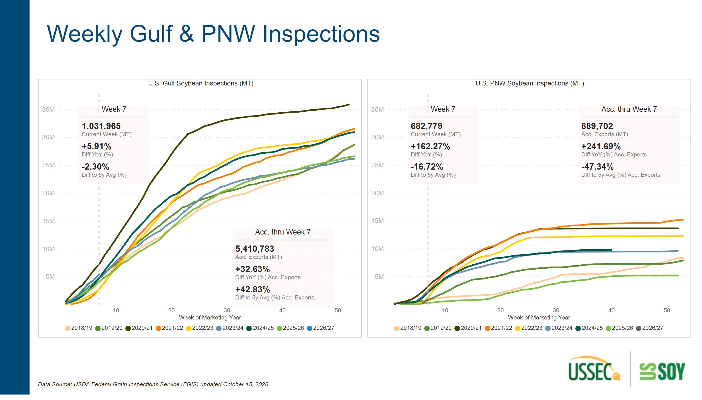
Inspections - Region
Notes:
Acc. thru Week 7
No alt text provided
Acc. thru Week 7
No alt text provided
U.S. PNW Soybean Inspections (MT)
No alt text provided
Week 7
No alt text provided
Week 7
No alt text provided
textbox
No alt text provided
U.S. Gulf Soybean Inspections (MT)
No alt text provided
textbox
No alt text provided

Slide 18
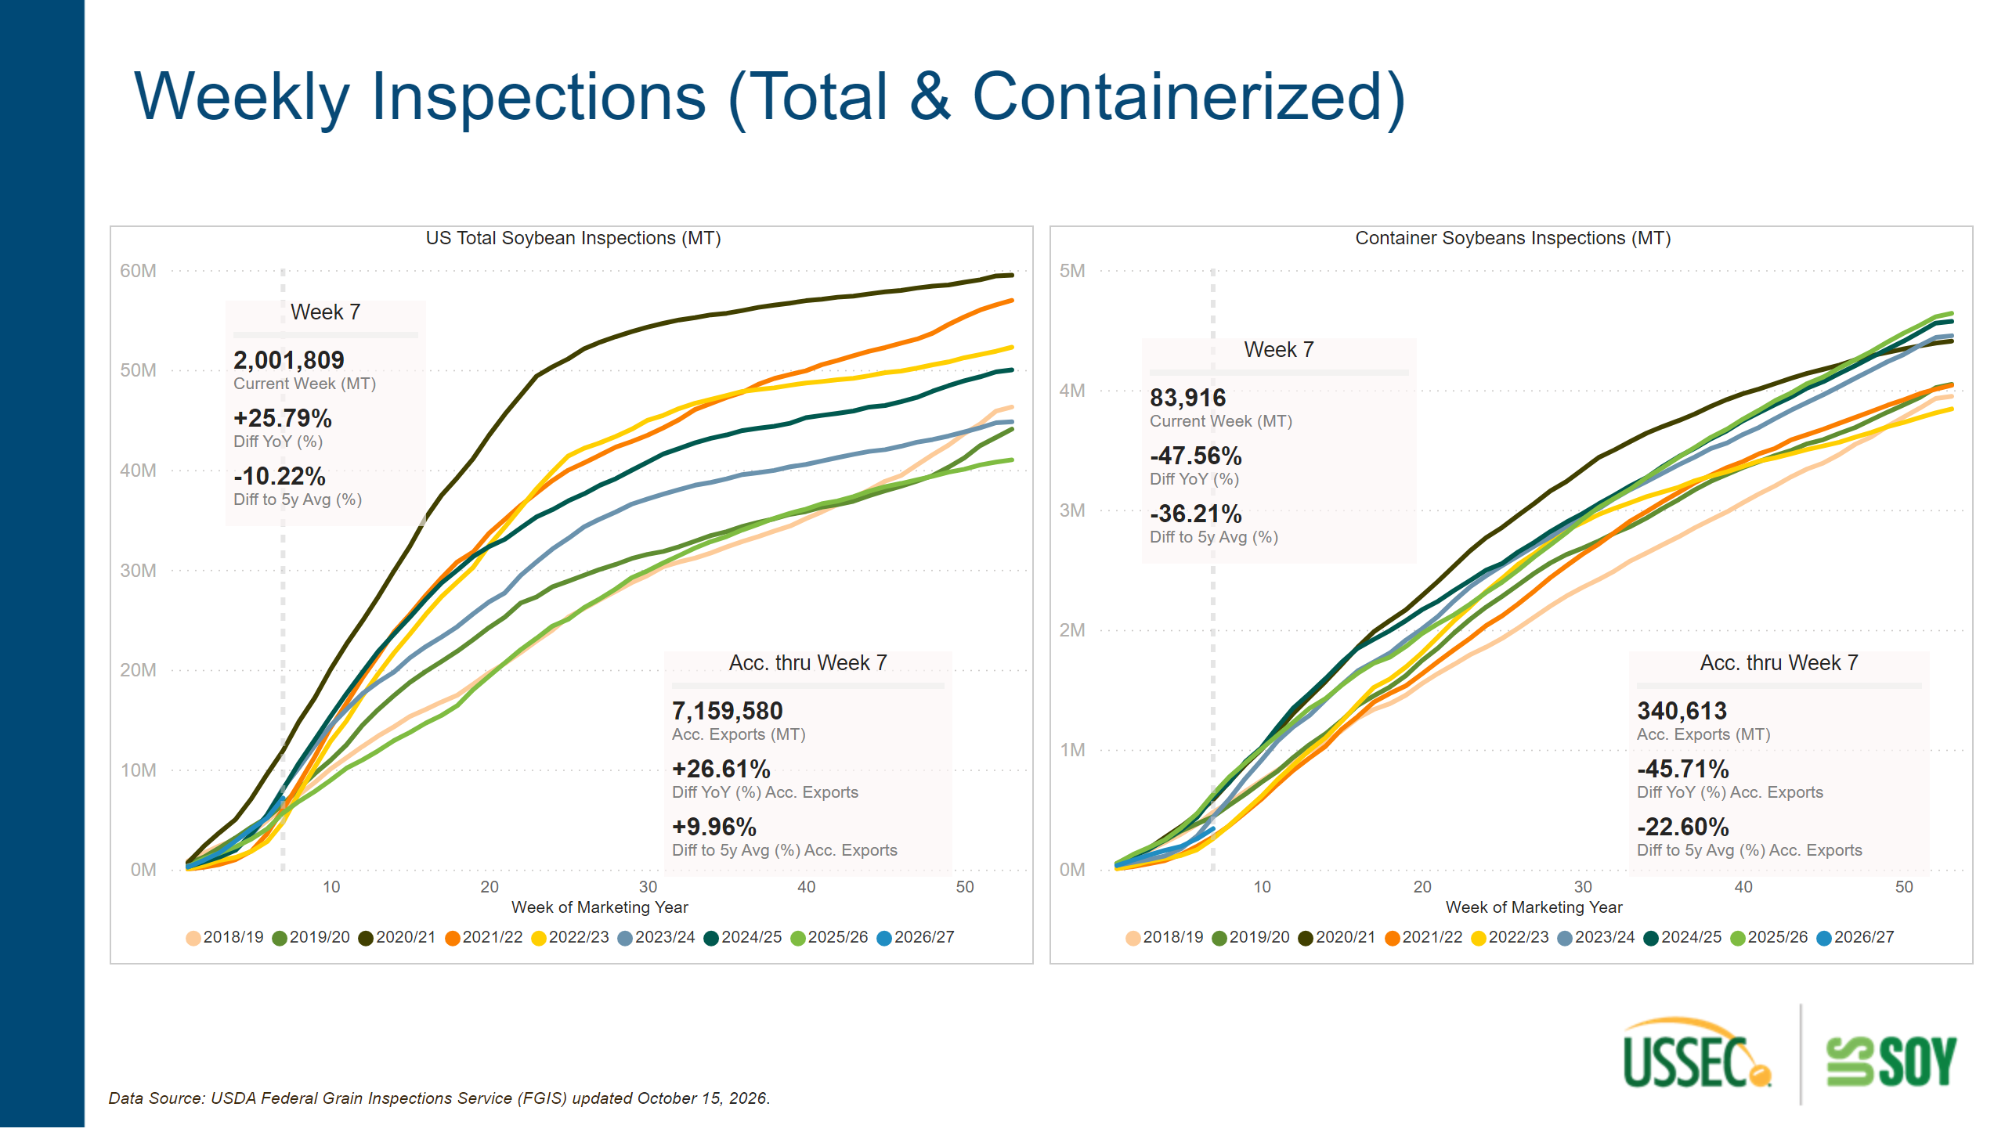
Inspections by Carrier
Notes:
Acc. thru Week 7
No alt text provided
US Total Soybean Inspections (MT)
No alt text provided
Acc. thru Week 7
No alt text provided
textbox
No alt text provided
Week 7
No alt text provided
Week 7
No alt text provided
textbox
No alt text provided
Container Soybeans Inspections (MT)
No alt text provided

Slide 19
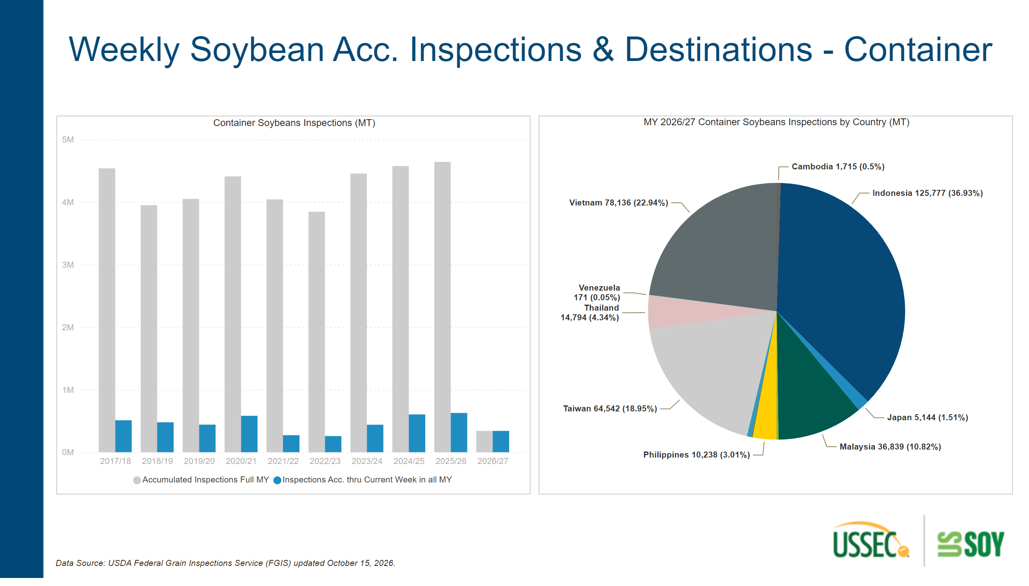
Inspections by Carrier and Country
Notes:
MY 2026/27 Container Soybeans Inspections by Country (MT)
No alt text provided
textbox
No alt text provided
Container Soybeans Inspections (MT)
No alt text provided
textbox
No alt text provided

Slide 20
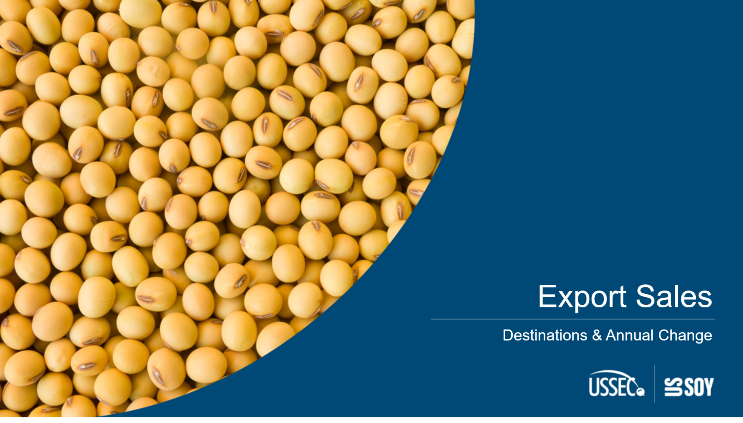
DestinationsCover
Notes:
shape
No alt text provided
textbox
No alt text provided
textbox
No alt text provided

Slide 21
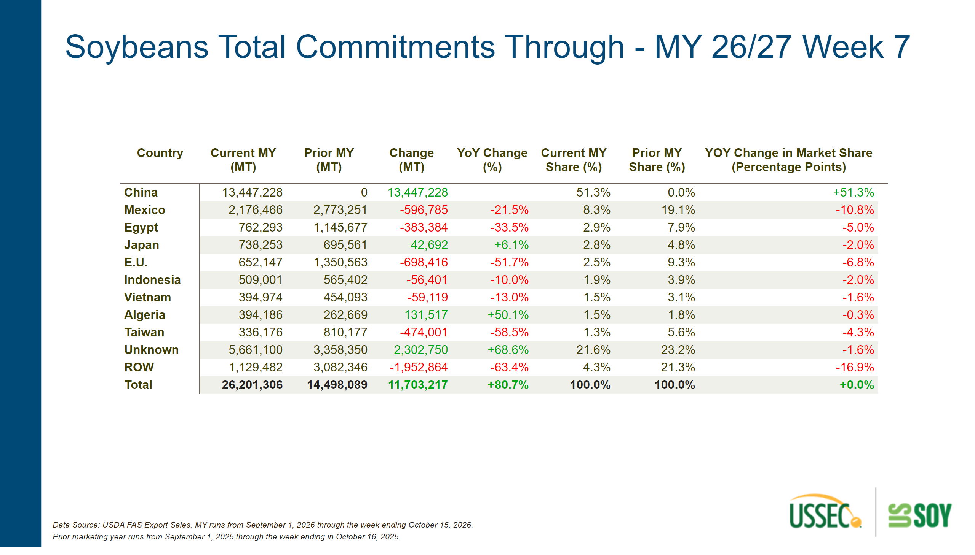
Commit- WSB
Notes:
shape
No alt text provided
textbox
No alt text provided
textbox
No alt text provided
pivotTable
No alt text provided

Slide 22
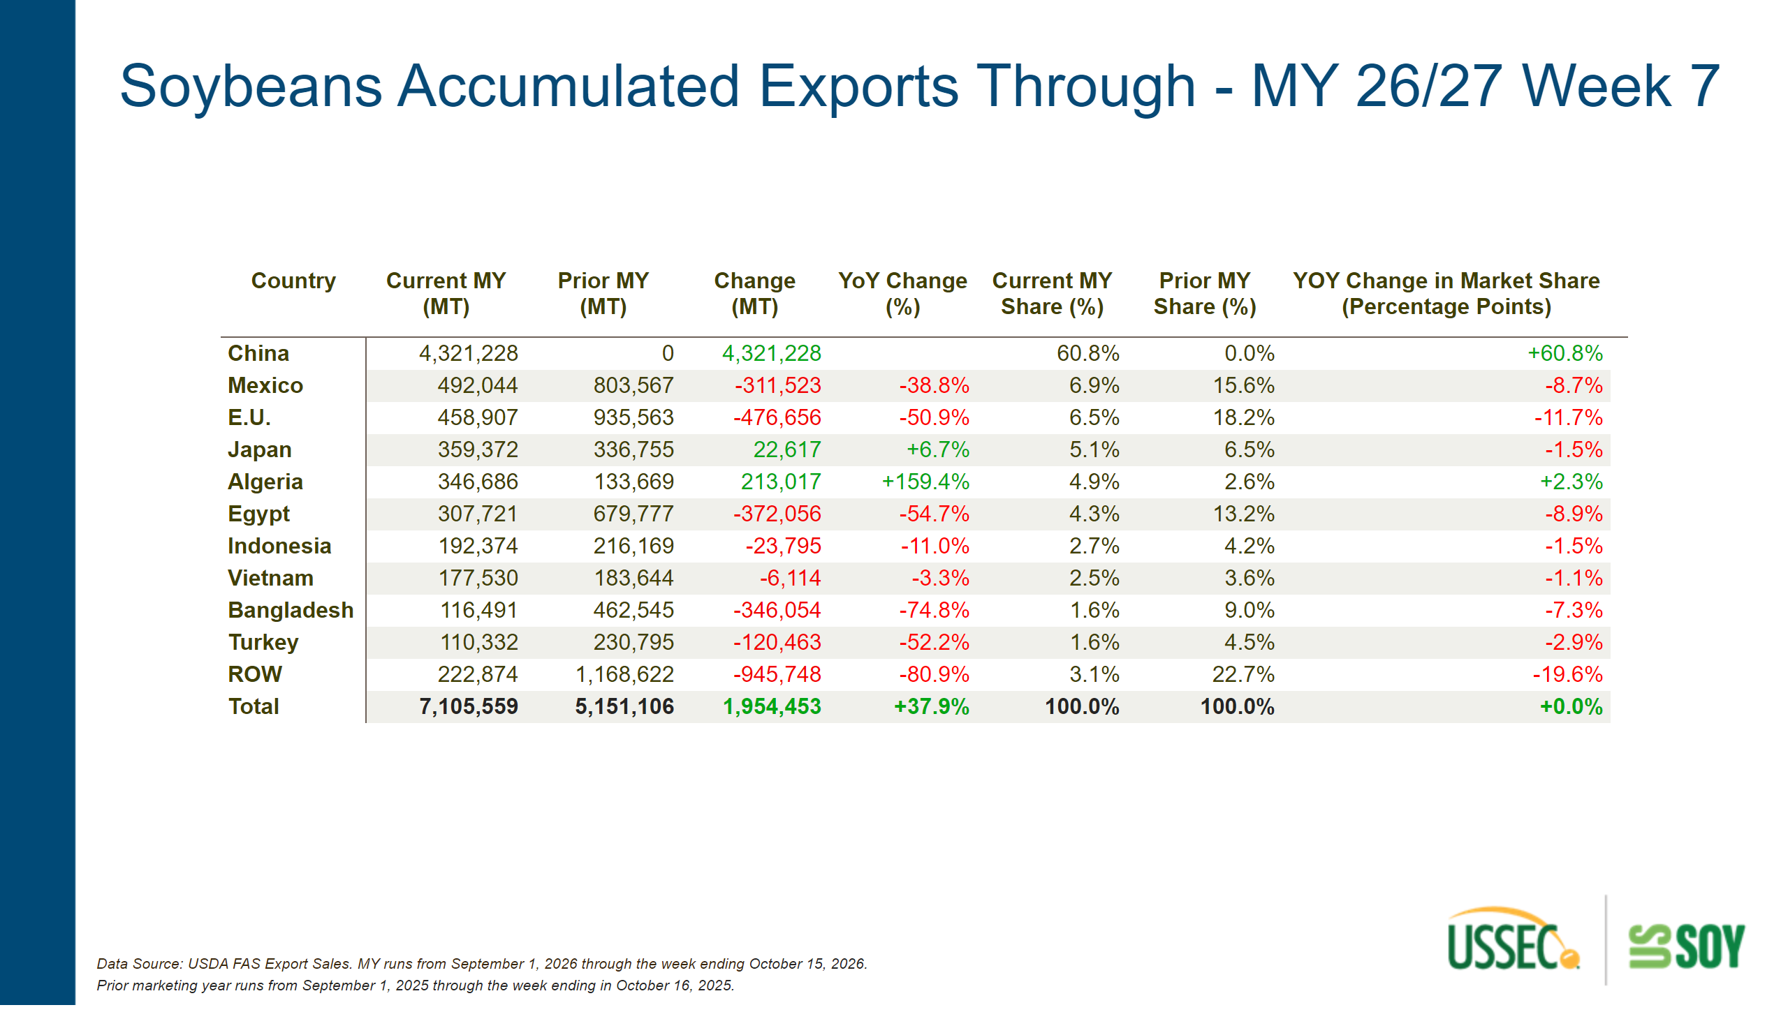
AccExp- WSB
Notes:
shape
No alt text provided
textbox
No alt text provided
textbox
No alt text provided
pivotTable
No alt text provided

Slide 23
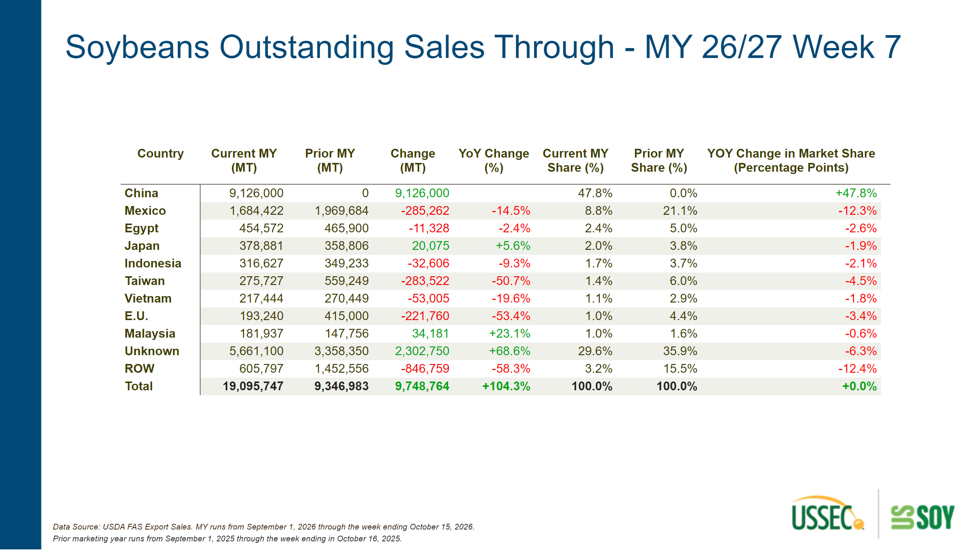
OutSales- WSB
Notes:
textbox
No alt text provided
textbox
No alt text provided
pivotTable
No alt text provided
shape
No alt text provided

Slide 24
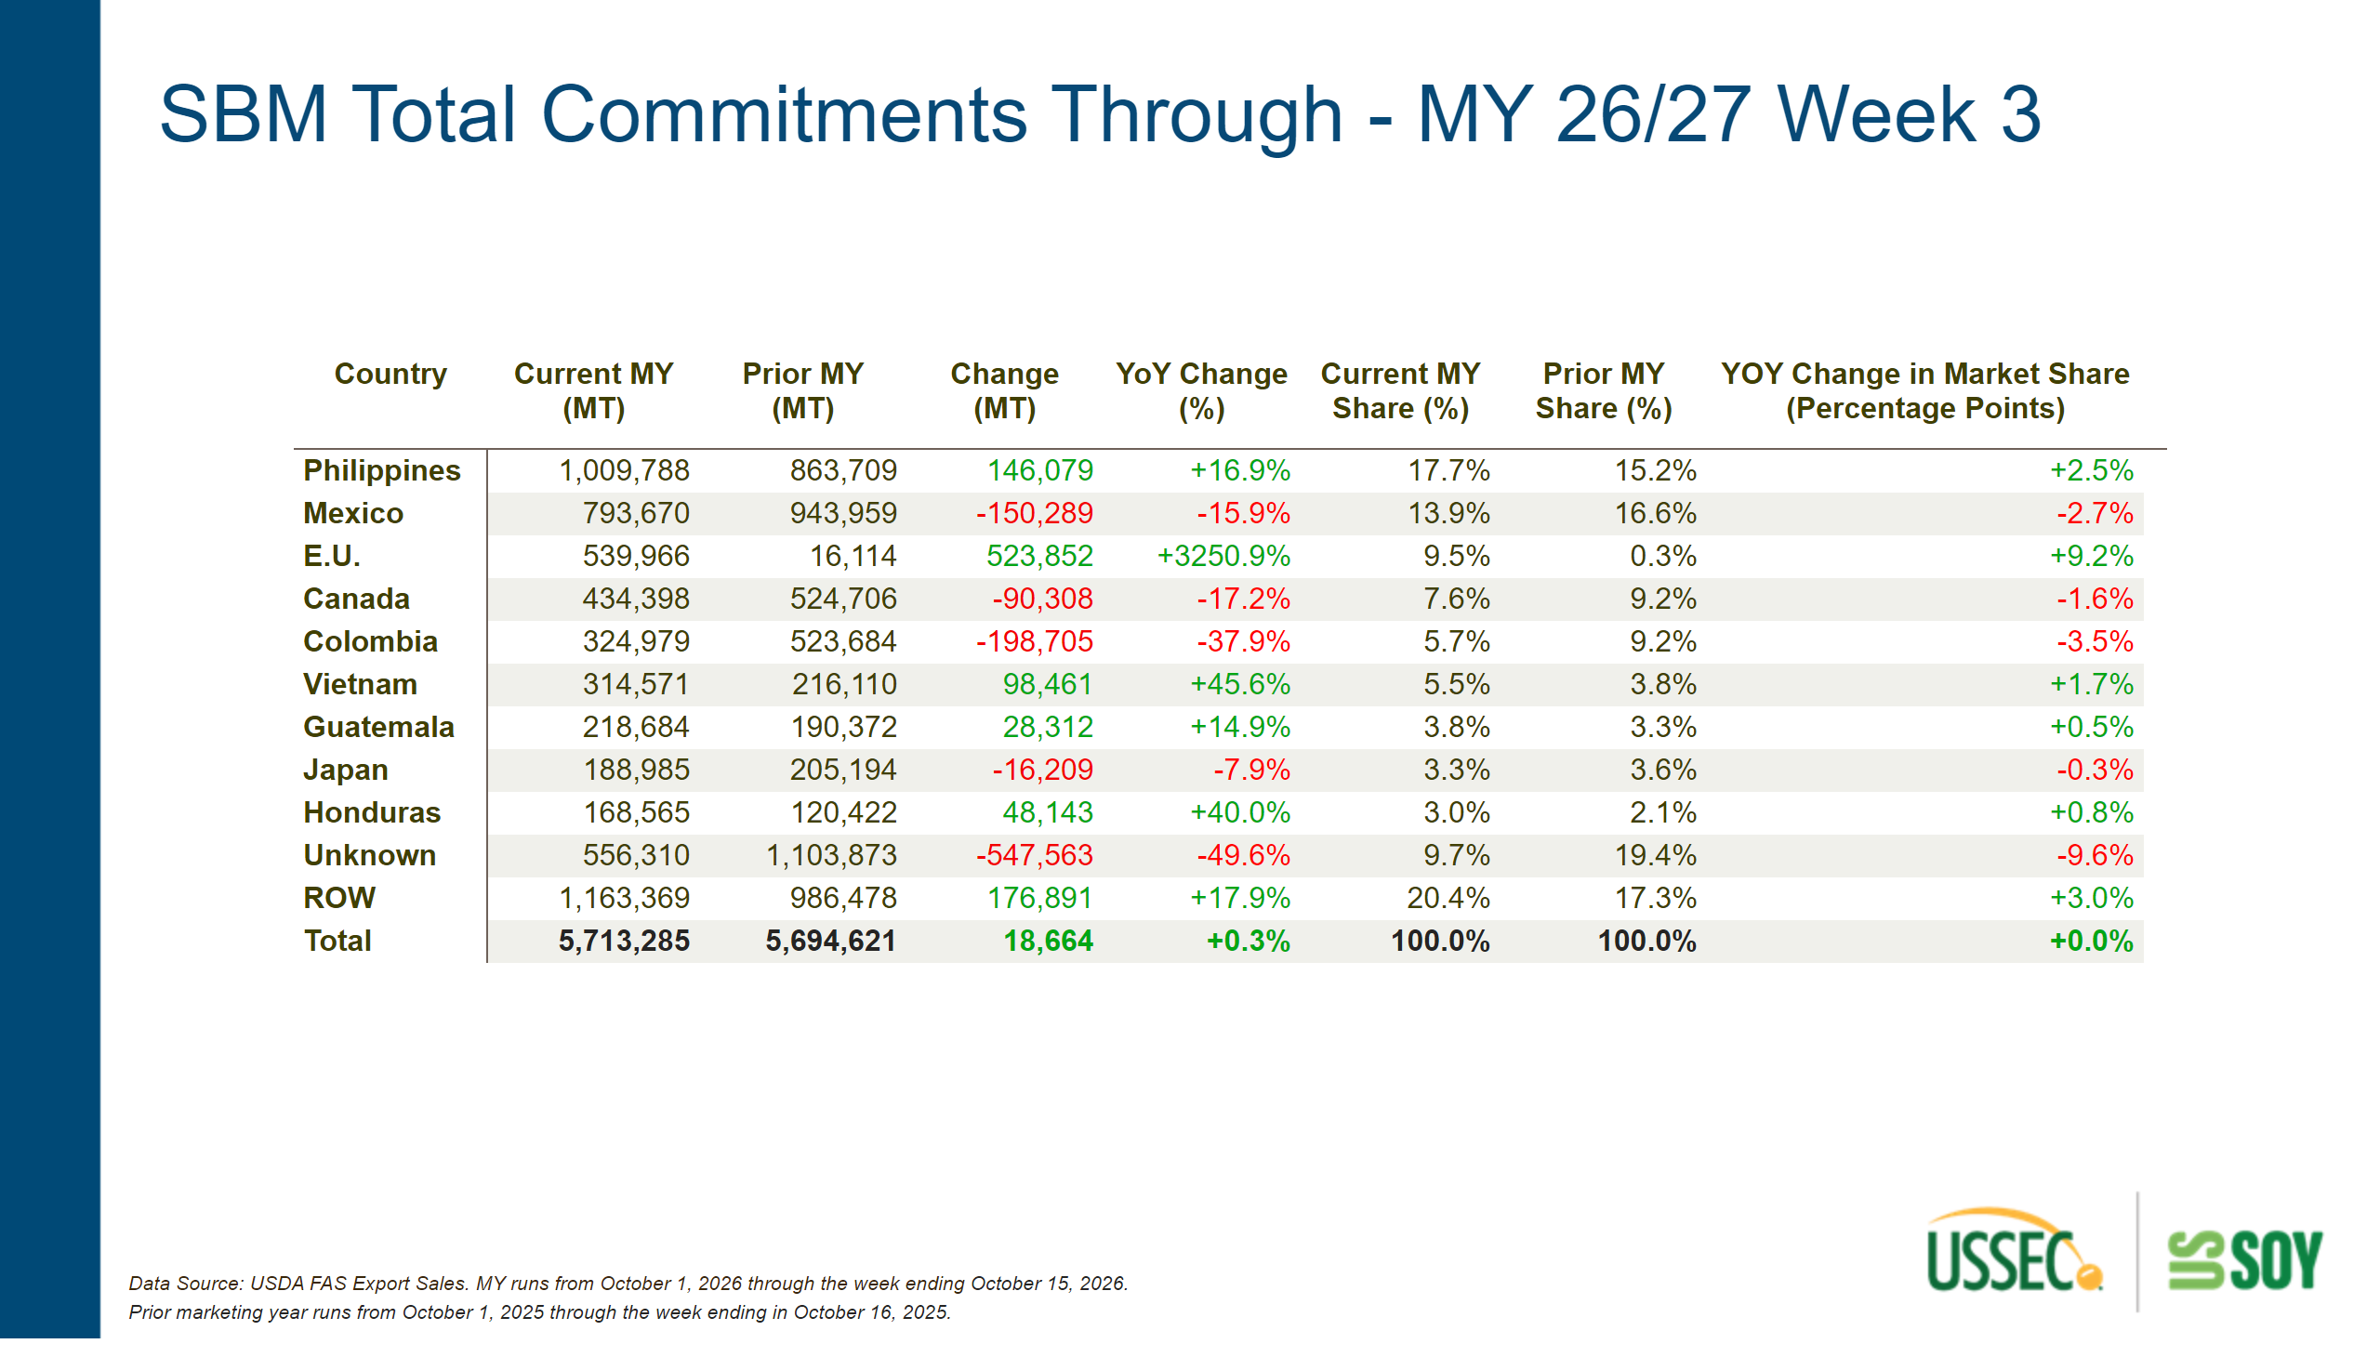
Commit- SBM
Notes:
shape
No alt text provided
textbox
No alt text provided
pivotTable
No alt text provided
textbox
No alt text provided

Slide 25
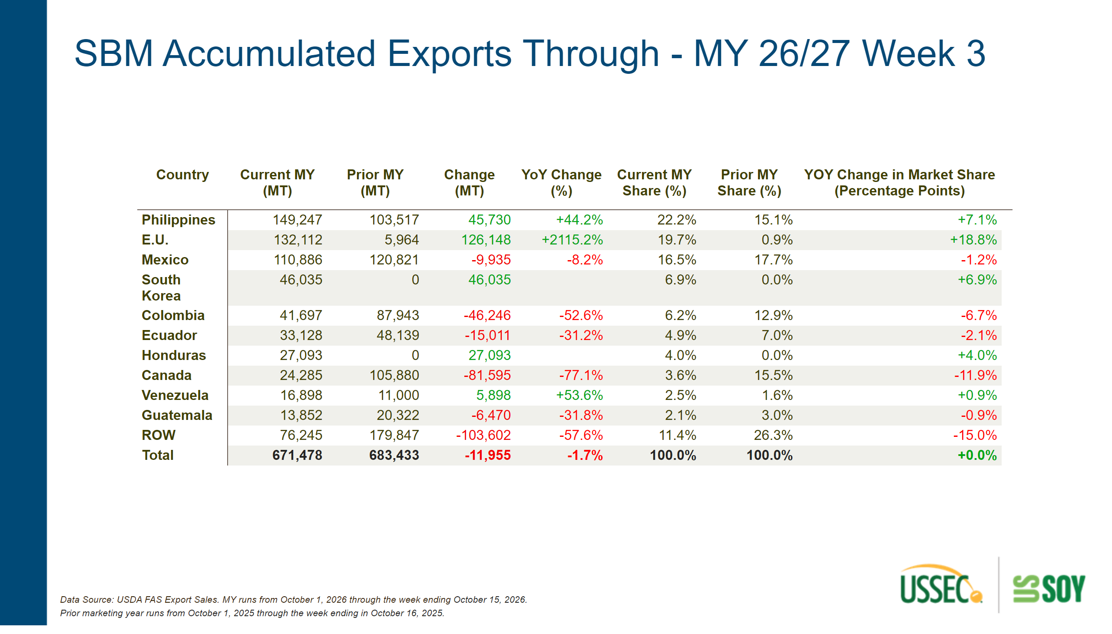
AccExp- SBM
Notes:
textbox
No alt text provided
pivotTable
No alt text provided
shape
No alt text provided
textbox
No alt text provided

Slide 26
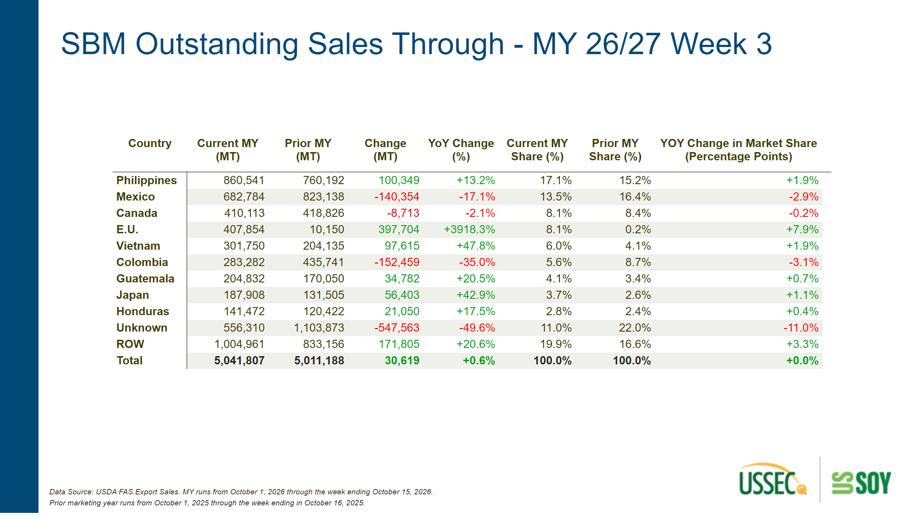
OutSales- SBM
Notes:
pivotTable
No alt text provided
textbox
No alt text provided
shape
No alt text provided
textbox
No alt text provided

Slide 27
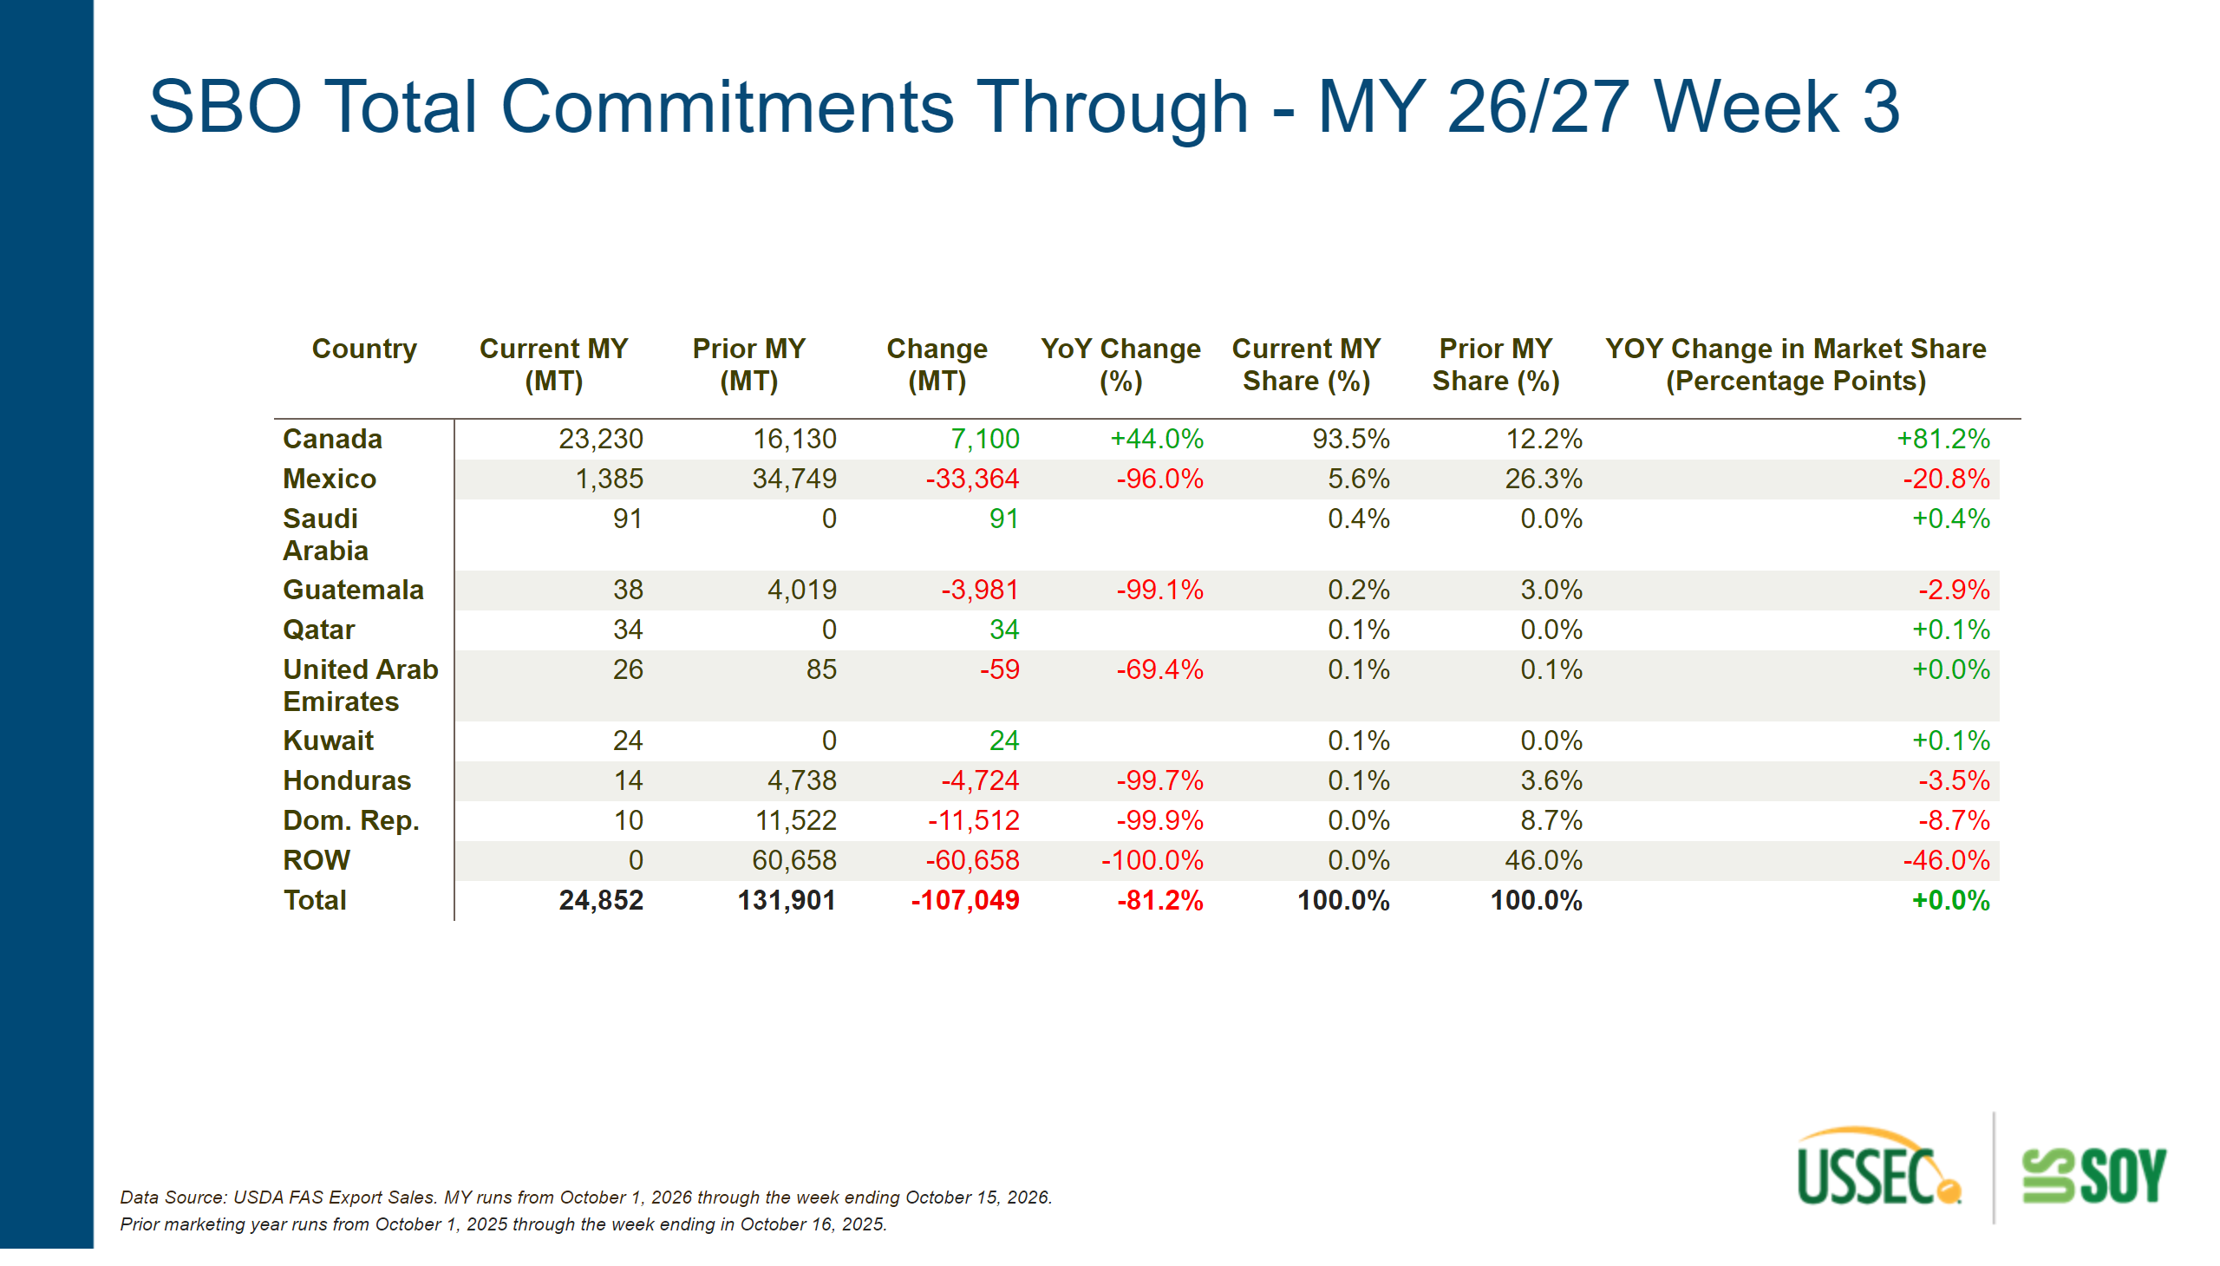
Commit- SBO
Notes:
textbox
No alt text provided
shape
No alt text provided
pivotTable
No alt text provided
textbox
No alt text provided

Slide 28
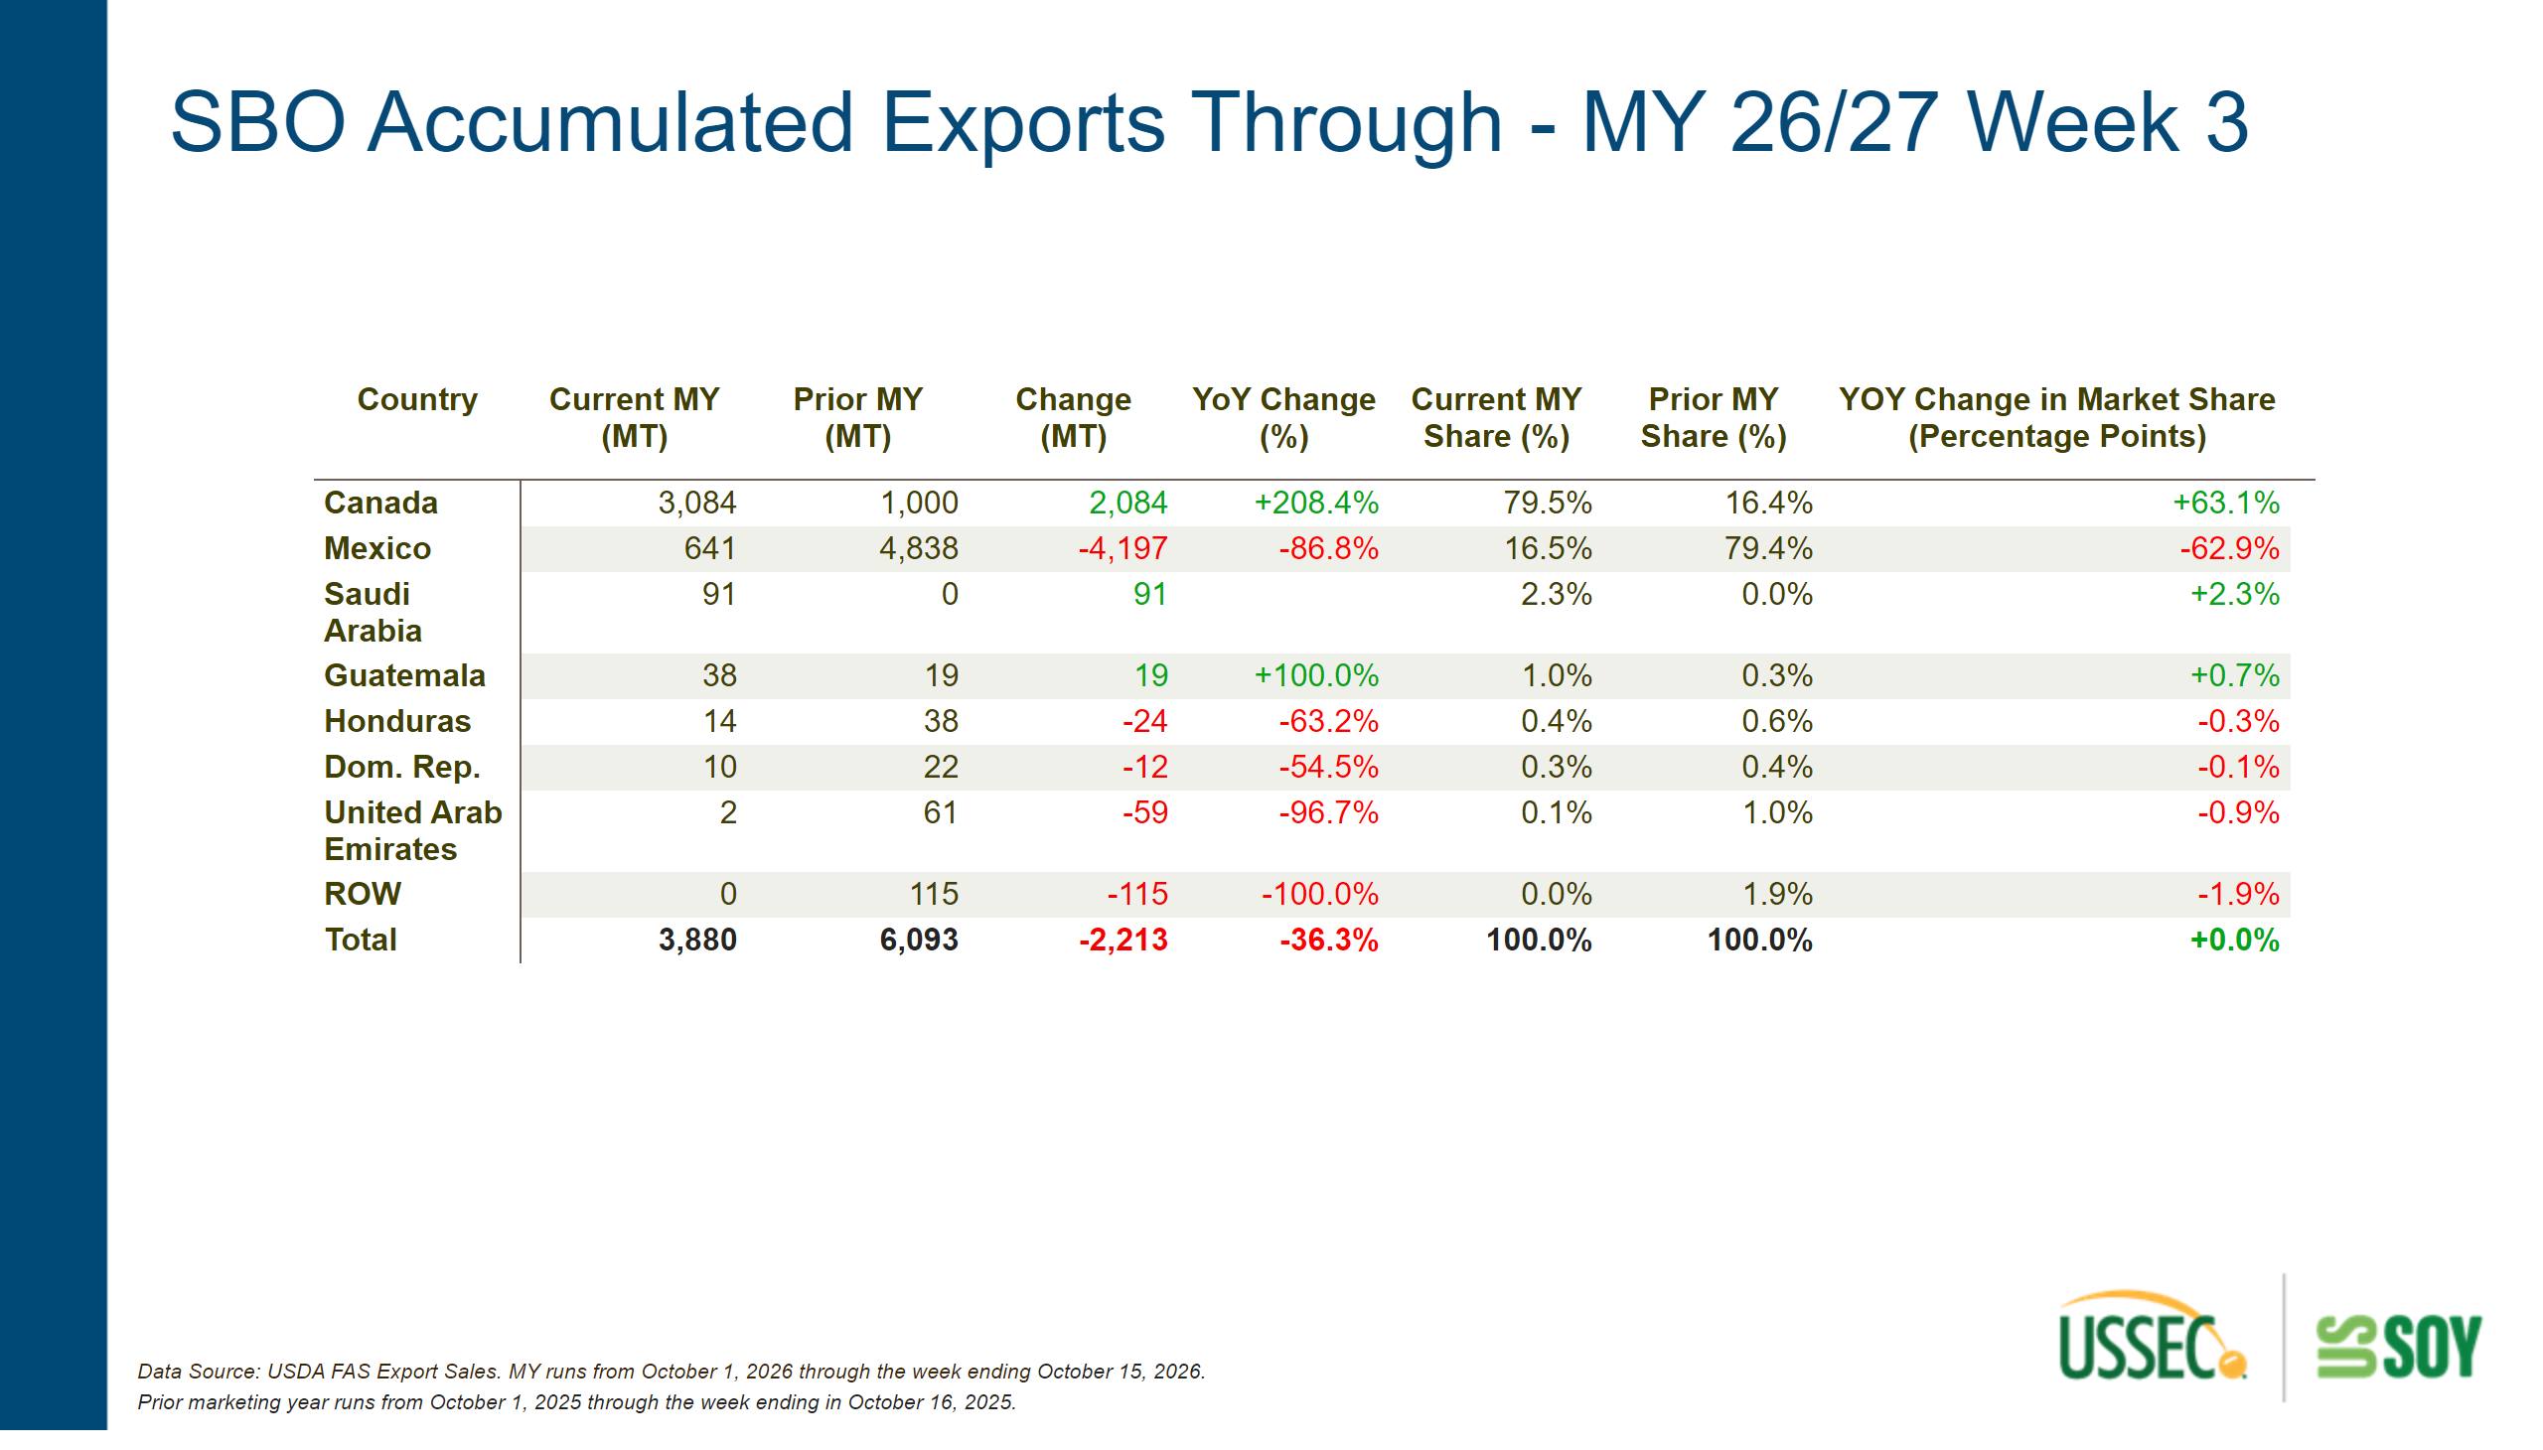
AccExp- SBO
Notes:
textbox
No alt text provided
shape
No alt text provided
pivotTable
No alt text provided
textbox
No alt text provided

Slide 29
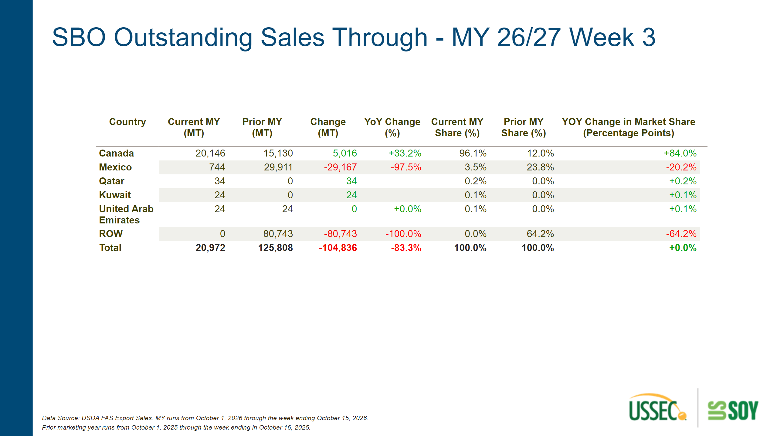
OutSales- SBO
Notes:
textbox
No alt text provided
shape
No alt text provided
textbox
No alt text provided
pivotTable
No alt text provided

Slide 30
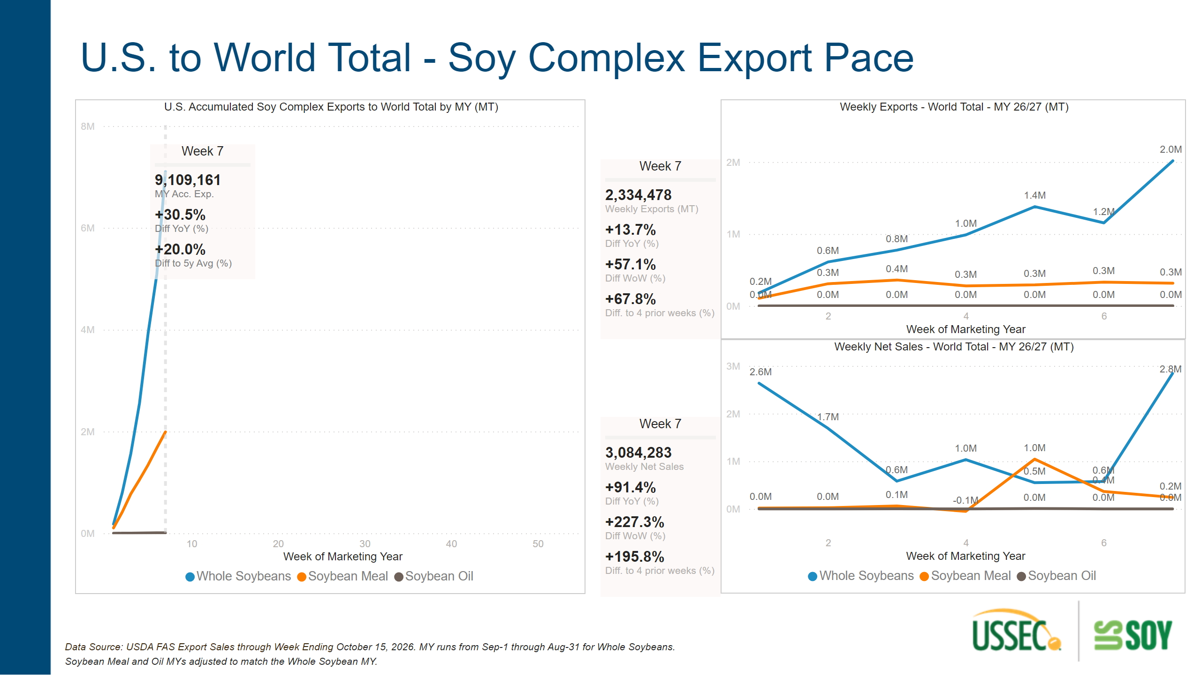
Export Pace - Soy Complex - World
Notes:
textbox
No alt text provided
Week 7
No alt text provided
Week 7
No alt text provided
Week 7
No alt text provided
textbox
No alt text provided
U.S. Accumulated Soy Complex Exports to World Total by MY (MT)
No alt text provided
Weekly Exports - World Total - MY 26/27 (MT)
No alt text provided
Weekly Net Sales - World Total - MY 26/27 (MT)
No alt text provided

Slide 31
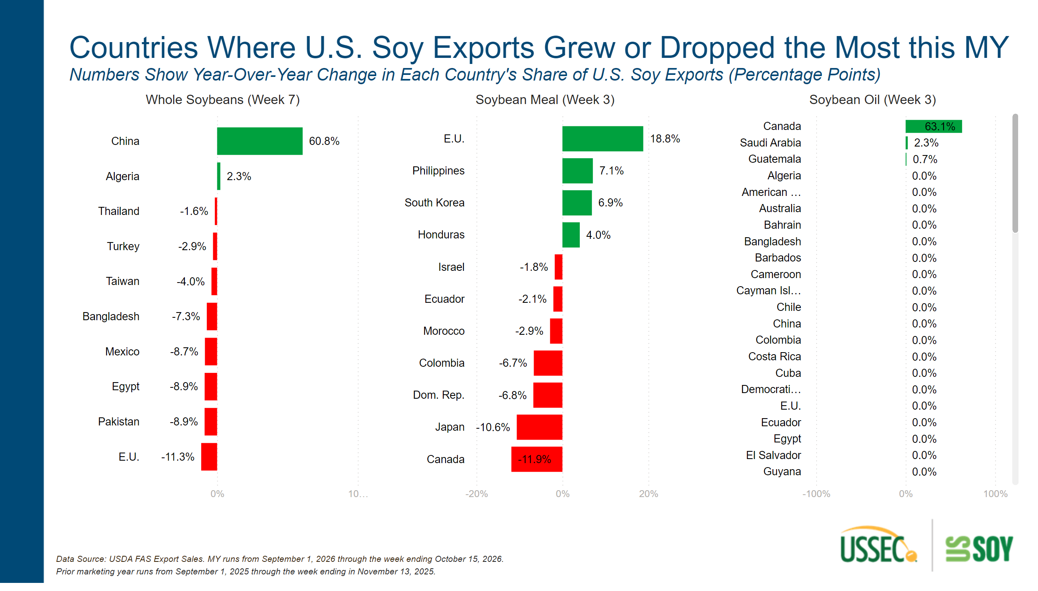
Top 10 MS Changes_Vertical
Notes:
Whole Soybeans (Week 7)
No alt text provided
textbox
No alt text provided
Soybean Meal (Week 3)
No alt text provided
textbox
No alt text provided
Soybean Oil (Week 3)
No alt text provided

